Slide 1
Acute Otitis media
Dr.smr.Azimi
Otorhinolaryngologist
Fellowship of rhinology

Slide 2
Definition/Symptoms and Signs
Acute otitis media (AOM)
Otitis media with effusion (OME)
Notes:
AOM generally is characterized by rapid
onset of signs and symptoms of infammation in the middle ear accom-
panied by middle ear effusion (MEE). Signs of infammation include
bulging or fullness of the tympanic membrane (TM), erythema of the
TM, and acute perforation of the TM with otorrhea.symptom include otalgia, irritability, and fever. OME, on the other hand, is
defned as MEE without signs and symptoms of acute infammation as
found in AOM.

Slide 3
AOM
Rapid onset of signs and symptoms of inflammation in the middle ear
Middle ear effusion (MEE)
Bulging or fullness of the tympanic membrane (TM)
Erythema of the TM
Acute perforation of the TM
Otorrhea
Otalgia, irritability, and fever
Notes:
AOM generally is characterized by rapid onset of signs and symptoms of inflammation in the middle ear accompanied
by middle ear effusion (MEE). Signs of inflammation include
bulging or fullness of the tympanic membrane (TM), erythema of the
TM, and acute perforation of the TM with otorrhea. Symptoms

Slide 4
OME
MEE without signs and symptoms of acute inflammation as found in AOM
Notes:
AOM generally is characterized by rapid onset of signs and symptoms of inflammation in the middle ear accompanied
by middle ear effusion (MEE). Signs of inflammation include
bulging or fullness of the tympanic membrane (TM), erythema of the
TM, and acute perforation of the TM with otorrhea. Symptoms

Slide 5
Physical Examination
Proper head and neck examination to identify predisposing conditions
Craniofacial anomalies such as those of Down syndrome and Treacher Collins syndrome
bifid uvula or a cleft palate
Hypernasality indicates velopharyngeal insufficiency
Hyponasality may be caused by obstructing adenoids, nasal polyposis or deviated septum
Notes:
proper head and neck examination is invaluable, because it may identify conditions that may
predispose the patient to otitis media. Hypernasality indicates velopharyngeal insufficiency, whereas hyponasality may be caused by obstructing adenoids or nasal obstruction due to nasal polyposis or deviated septum
hyponasality /hy·po·na·sal·i·ty/ (-na-zal´it-e) a quality of voice in which there is a complete lack of nasal emission of air and nasal resonance, so that the speaker sounds as if he has a cold.
hypernasality /hy·per·na·sal·i·ty/ (-na-zal´ĭ-te) a quality of voice in which the emission of air through the nose is excessive due to velopharyngeal insufficiency; it causes deterioration of intelligibility of speech.

Slide 6
Physical Examination
Pneumatic otoscopy; assessment of the TM and its mobility
The normal TM is translucent and concave and moves briskly with positive and negative pressure
The assessment of the TM should note position, color, degree of translucency, and mobility
Reduced or no mobility of TM results from perforation of TM, effusion in the middle ear or increased stiffness due to scarring or increased thickness of the TM

Slide 7
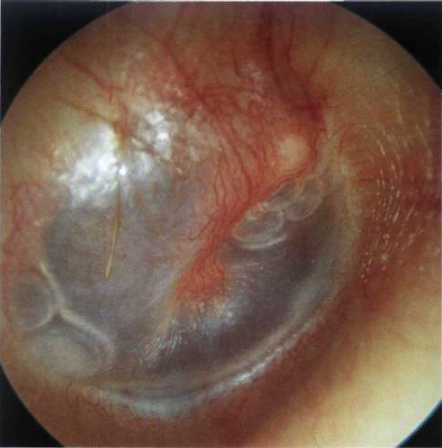
Notes:
Right ear. Secretory otitis media. Air bubbles can
be seen anterior to the handle of the malleus and also in the
posteroinferior quadrant.

Slide 8
Position of the TM
ranges from severely retracted to bulging
Severely retracted TM usually is associated with effusion
Mild to moderate retraction indicates negative pressure, MEE, or both
Fullness and bulging of the TM are caused by increased pressure or fluid, or both
Notes:
The position of the TM ranges from severely retracted to bulging. Mild to moderate retraction indicates negative pressure, MEE, or both, whereas
a severely retracted TM usually is associated with effusion. Fullness and bulging of the TM are caused by increased pressure or fluid, or both,
in the middle ear.

Slide 9
Opacification of the TM
may be caused by thickening or scarring or presence of MEE
A red but translucent TM is a typical finding in a crying or sneezing infant
A “red” TM that is full or bulging is a sign of AOM
A pink, gray, yellow, or blue retracted TM with reduced or no mobility usually is seen with OME
Notes:
Opacification of the TM may be caused by thickening or scarring or presence of MEE. A red but translucent TM is a
typical finding in a crying or sneezing infant, secondary to engorgement of blood vessels in the TM. On the other hand, a “red” TM that is full
or bulging often is a sign of AOM.

Slide 11
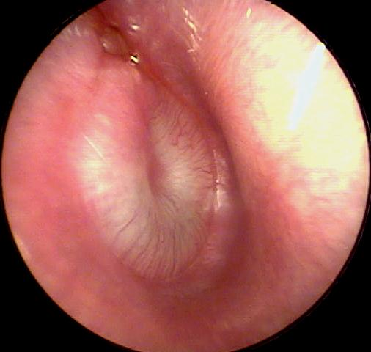
AOM (pus behind the eardrum)

Slide 12
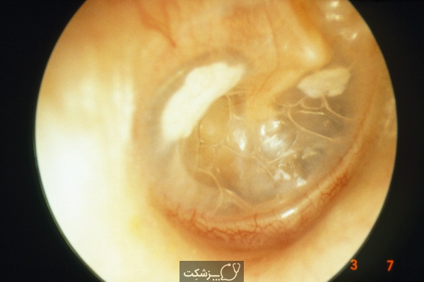

Slide 13
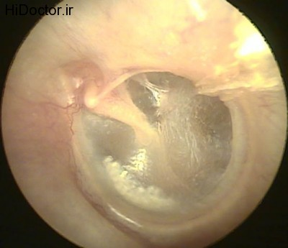

Slide 14
Immittance Testing (Tympanometry)
When otoscopic evaluation is inconclusive or difficult to perform (in children older than 6 months)
Screening as well as follow up

Slide 15
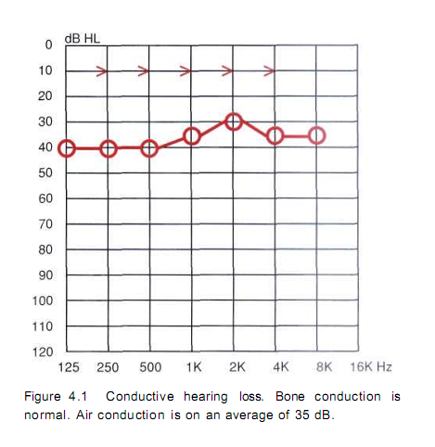
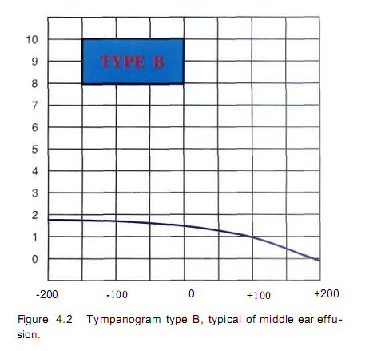
Ome

Slide 16
Pathophysiology and Pathogenesis

Slide 17
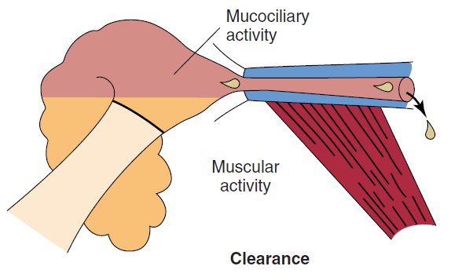
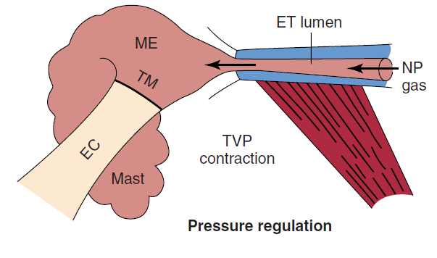
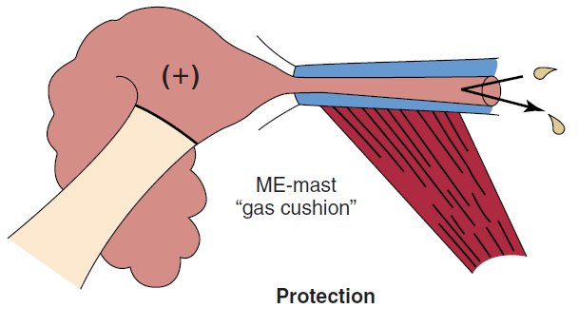
Pathophysiology and Pathogenesis
Eustachian Tube Function
The eustachian tube in the infant is shorter, wider, and more horizontal than in the adult
physiologic functions of the eustachian tube
pressure regulation (ventilation)
Protection
Clearance (drainage)

Slide 18
Bacteriology
Otitis media was diagnosed in 39% of children by 9 months and 62% of children by 2 years of age.
Streptococcus pneumoniae was the single most common bacterial pathogen in AOM
Haemophilus influenzae
Moraxella catarrhalis

Slide 19
Bacteriology

Slide 20
virology
Viral Infection of the upper respiratory tract mucosa initiates the whole cascade of events that finally leads to the development of AOM

Slide 21
Allergy and Immunology
Allergy may induce inflammatory swelling of the eustachian tube mucosa
Allergies produce inflammatory obstruction of the nose
Bacteria-laden allergic nasopharyngeal secretions may be aspirated into the middle ear

Slide 22
Risk Factors
Age; 6 and 11 months of age, first onset out of this range is a powerful predictor of recurrence
Allergy; higher frequency of OME and MEE in allergic children than in nonallergic children
Immunocompetence; Children with recurrent otitis media may have a defect in the immune system
Cleft Palate/Craniofacial Abnormality; Otitis media is considered “universal” in infants younger than 2 years of age with unrepaired cleft palate

Slide 23
Risk Factors
Environmental risk factors;
day care attendance,
number of siblings,
tobacco smoke exposure,
Bottle feeding,
birth weight,
Socioeconomic status
Air pollution

Slide 24
Risk Factors
The incidence of AOM is highest during the fall and
winter months and lowest during spring and summer months, which parallels the incidence of URI

Slide 25
Prevention of Disease
Promotion of breastfeeding
Avoidance of supine bottle feeding and pacifier use,
elimination of passive tobacco smoke
influenza and Streptococcus pneumonia vaccine

Slide 26
Treatment
Observation
Medical treatment
Antibiotics
Decongestants/Antihistamines
Steroids
Surgical treatment
Myringotomy/Tympanocentesis
Myringotomy with Tympanostomy Tube Insertion
Adenoidectomy with and without Tonsillectomy

Slide 27
Treatment of AOM
Observation
Sever disease
moderate to severe otalgia
temperatures higher than 39°C orally or 39.5°C rectally,
toxic-appearing child
Notes:
Children for whom this is an option are to be selected on the basis of diagnostic certainty, age, illness severity, and
access to medical care. Severe disease is defined as moderate to severe
otalgia, fever with temperatures higher than 39° C (102° F) orally or
39.5° C rectally, or a toxic-appearing child. Children younger than 6
months of age should be treated with antibiotics regardless; children 6
to 23 months, if the illness is nonsevere, may be observed if the diagnosis
is uncertain, but if AOM is certain or severe, the child should be
treated with antibiotics; children 24 months or older may be watched
if the diagnosis is uncertain or disease is nonsevere but treated if AOM
is severe.

Slide 28
Treatment of AOM (algorithm)
<6 month
6-24 month
> 24 month
Diagnosis uncertain?
Sever disease?
Sever disease?
Yes
No
Yes
AB therapy
Yes
No
Observe
Diagnosis certain?
No

Slide 29
Treatment of AOM (choices)
Amoxicillin is still the first-line antibiotic for non-severe episodes of AOM
90 mg/kg per day in two divided doses
For severe episodes of AOM, Co-amoxiclav
for a 10 KG child 5.5 ml of Farmentin 457 q12h
If penicillin allergy; cephalosporin
Both penicillin and cephalosporin allergy; macrolids

Slide 30
Treatment of AOM (failure)
Treatment failure; persistence or recurrence of symptoms and signs 48 to 72 hours after institution of initial treatment
Start antibiotic if the patient was under observation
Change amoxicillin to co-amoxiclav
Change co-amoxiclav to ceftriaxone for 3 days
Tympanocentesis should always be considered if the child does not respond to the antibiotic

Slide 31
Treatment of AOM (duration)
<6 years old and sever cas➔10 day course
>6years ➔5-7 day course
azithromycin may be given for 1-, 3-, and 5-day courses
one dose of IM ceftriaxone may be given
neither decongestants or antihistamines, nor their combinations, and steroids are recommended for the treatment of AOM

Slide 32
Treatment of RECURRENT AOM
Antibiotic Prophylaxis
Continuous
Intermittent
Myringotomy or tympanocentesis
relief of pain, sample for culture
Tympanostomy tube insertion
preventive
medical treatments failure of recurrent AOM
Adenoidectomy may provide modest improvement in children with recurrent AOM but is not recommended as a first-line procedure unless indicated for airway obstruction
Notes:
Studies generally have concluded that antimicrobials are effective in preventing disease.129 This method of managing children with
recurrent AOM is not recommended, however, because of the potential for increasing resistant organisms. Rather than daily medicine given for
months at a time, treating intermittently at the time of upper respiratory tract symptoms has been tried, but efficacy is less than with continuous
medication.
a myringotomy or tympanocentesis is helpful for relief of pain and allows samples to be obtained for culture to identify the pathogen and to guide in the selection of antibiotics, but provides no advantage in duration of effusion or recurrence of episodes of AOM

Slide 33
Treatment of Otitis Media with Effusion
Hearing loss level
<20 db
21-39 dB
> 40 dB
Sever or long standing symptoms (>4 month)
No
Yes
examination at 3- to 6-month intervals
surgery
hearing loss, language, learning delays, or suspected structural abnormalities of the ear
drum

Slide 34
Treatment of Otitis Media with Effusion
Decongestant/Antihistamine, antibiotics or steroids are not recommended
Autoinflation might be considered for use while awaiting spontaneous resolution of the effusion
Tympanostomy tube insertion is the initial preferred procedure
Adenoidectomy should not be performed except for a specific indication (i.e., nasal obstruction, chronic adenoiditis)
Repeat surgery consists of adenoidectomy plus myringotomy with/without tympanostomy tube insertion

Slide 36
Treatment of Otitis Media with Effusion
Decongestant/Antihistamine, antibiotics or steroids are not recommended
Autoinflation might be considered for use while awaiting spontaneous resolution of the effusion
Tympanostomy tube insertion is the initial preferred procedure
Adenoidectomy should not be performed except for a specific indication (i.e., nasal obstruction, chronic adenoiditis)
Repeat surgery consists of adenoidectomy plus myringotomy with/without tympanostomy tube insertion

Slide 37
Tympanostomy tube

Slide 38
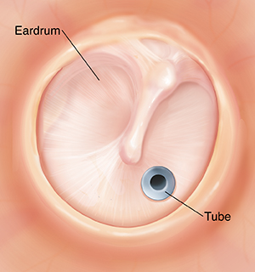
Ventilation tube

Slide 39
mastoiditis
significant erythema ,edema, and tenderness of
the postauricular region. This is the typical presentation of acute mastoiditis. Otoscopy revealed findings consistent with acute otitis media.

