Slide 1
Fungal Sinusitis
Dr.smr.Azimi
Otorhinolaryngologist
Fellowship of rhinology

Slide 2
Definition
Inflammation of the sinuses due to a fungus

Slide 3
Fungal Sinusitis
Causative fungi:
Aspergillus (most common)
Rhizopus (mucormycosis)
Candida
Histoplasma
Blastomces
Coccidioides
Cryptococcus

Slide 4
Fungal Sinusitis
Major risk factors:
Granulocytopenia
multiple prolonged courses of antibiotics or steroids
AIDS

Slide 5
Classification
Non Invasive Fungal Sinusitis
- Allergic
- Fungus Ball (Mycetoma)
Invasive Fungal Sinusitis
- Acute
- Chronic

Slide 6
Allergic Fungal Sinusitis
Most common form
Warm humid climate
Among younger, immuno-competent, atopic
Hypersensitivity reaction to inhaled fungus organism
Presents with Nasal polyps & thick greenish mucus

Slide 7
Investigations
Total IgE 
CT Scan PNS- Sinus filled with high signal intensity soft tissue with calcium deposits, thinning/ pressure bony erosion & remodelling
Histology of greasy mucous- branching, non invasive fungal hyphae, eosinophils & Charcot-Leyden crystals

Slide 8
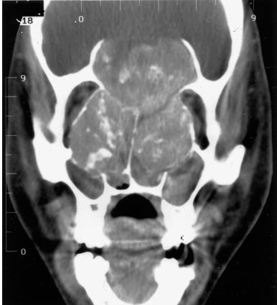
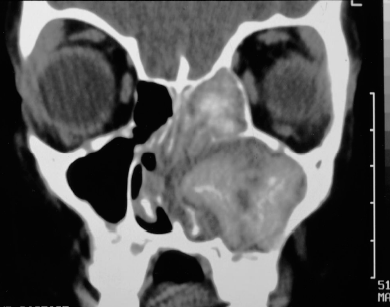

Slide 9
Treatment
Surgical clearance of sinuses
Topical Steroids
Antihistamines
Immunotherapy
? Antifungal

Slide 10
Fungus Ball (Mycetoma)
Older individuals, usually females
Immunocompetent
Asymptomatic/ Cacosmia/ Chronic sinusitis
Fungal mass limited to one sinus
CT Scan- Hyperdense mass with punctate calcifications

Slide 11
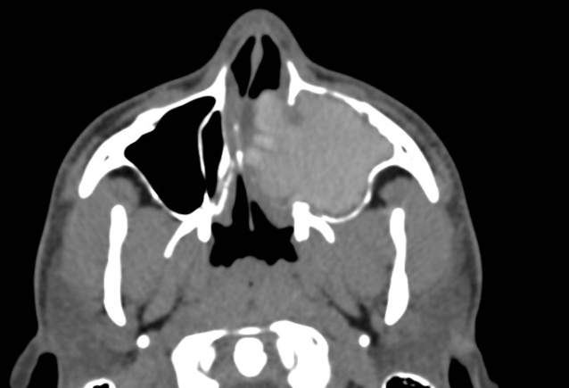

Slide 12
Fungus Ball- Treatment
Surgical clearance
? Anti fungal

Slide 13
Acute Invasive Fungal Sinusitis
Most lethal form
Immunocompromised/ Diabetics
Caused by Mucorales, Aspergillus, Fusarium
Angio invasion, hematogenous spread
Local necrosis, orbital & intracranial spread
Fever, pain, nasal congestion, epistaxis, proptosis, headaches, seizures

Slide 14
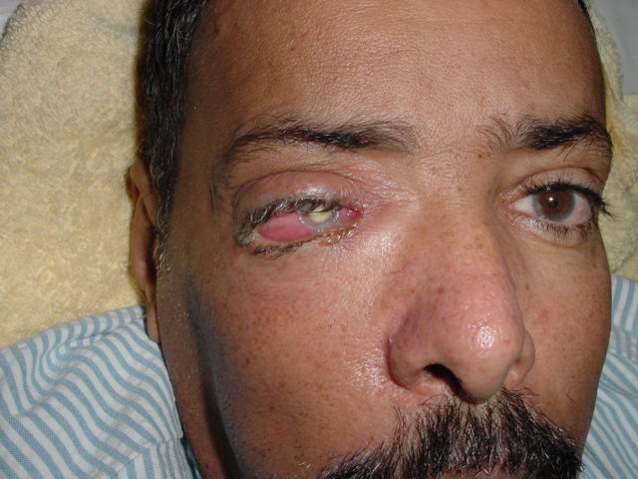
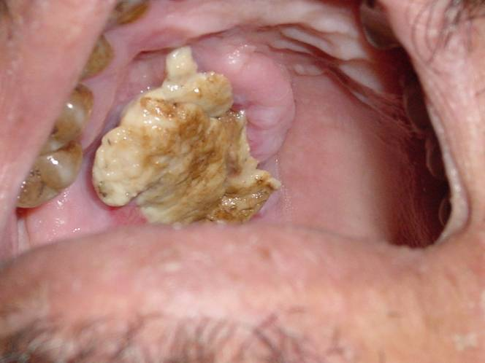

Slide 15
Invasive or Acute Fulminant Fungal Sinusitis
Facial soft tissue tenderness/numbness
rhinorrhea
Fever
Gray, friable, anesthetic nasal tissue
May have necrotic black tissue
May have bloody rhinorrhea

Slide 16
AIFS- CT Findings
Unilateral nasal soft tissue thickening
Bony erosions
Unilateral involvement of PNS
Proptosis
Cavernous sinus thrombosis

Slide 17
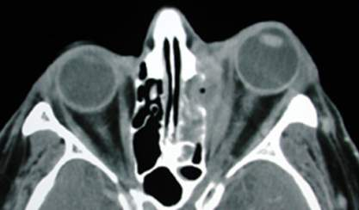
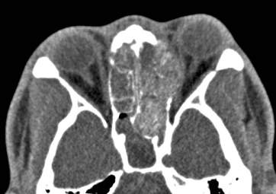
Acute Invasive Fungal Sinusitis - CT
Unilateral ethmoid involvement with bone destruction, intraorbital spread and proptosis

Slide 18
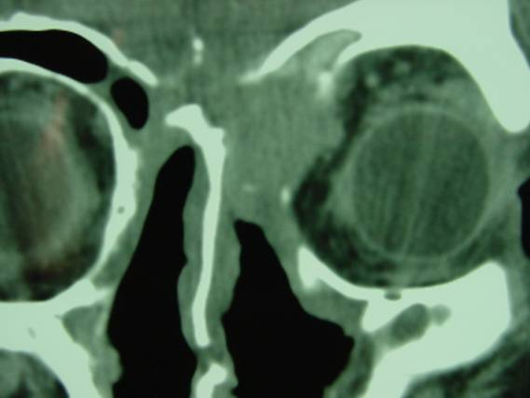

Slide 19
AIFS- Treatment
Aggressive surgical debridement
Systemic anti fungal therapy
Treatment of underlying cause of immunosuppression

Slide 20
Chronic Invasive Fungal Sinusitis
Immunocompetent with H/o Ch sinusitis
Progressin over months to years
Maxillofacial soft tissue swelling
Orbital involvement  proptosis, visual loss
Intracranial extension with cranial neuropathies, headaches seizures
CT Scan- Hyperdense mass, bone erosion

Slide 21
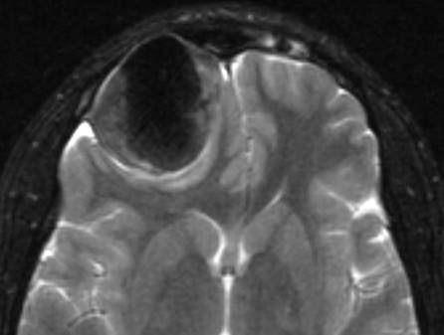
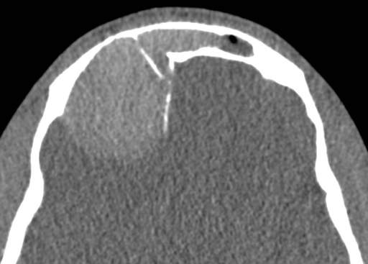

Slide 22
CIFS- Treatment
Aggressive surgical exenteration
Systemic anti fungal therapy

