Slide 1
Chronic Sinusitis
Dr.smr.Azimi
Otorhinolaryngologist
Fellowship of rhinology

Slide 2
Definition
Inflammation of the Paranasal Sinuses lasting > 3 months

Slide 3
Etiology
Anatomical variations
Deviated Nasal Septum
Concha Bullosa
Bulla Ethmoidalis
Underlying diseases
Cystic Fibrosis
Ciliary Dyskinesia
Immuno-deficiency
Granulomatous diseases (wegner)

Slide 4
Microbiology
Anaerobes
Staphylococcus aureus
Streptococcus
H. Influenzae
M. catarrhalis

Slide 5
Pathophysiology
Obstruction of Osteomeatal complex region
Impaired mucociliary clearance
Stagnation & pooling of secretions
Infection  Vicious cycle

Slide 6
Symptoms
Chronic nasal obstruction
Purulent post nasal discharge
Pain over sinuses/ Headache
Halitosis
Chronic cough

Slide 7
Investigations
X-ray PNS
CT Scan PNS
Sinus lavage
Sinus aspirate/ Pus swab for C/S

Slide 8
Treatment
Antibiotics – Ciprofloxacin, Augmentin, Clarithromycin, Cefuroxime, Clindamycin, Metronidazole
Decongestants
Antihistamines
Steroid Nasal Drops/ Sprays
Surgery- To provide drainage & ventilation

Slide 9
Operative procedures on Sinuses

Slide 10
Maxillary Sinusitis
Antral Washout
Inferior Meatal Antrostomy
Caldwell-Luc’s Operation
FESS

Slide 11
Caldwell-Luc’s Surgery
Anterior wall of the Maxillary sinus is entered through a Sub-labial incision
A window is created in the medial wall through Antrostomy
Indications
- Ch sinusitis refractory to treatment
- Repair of Oro-antral fistula
- Reccurrent AC polyp
- Blow out fracture of floor of orbit
- Approach to ethmoids/ PPF

Slide 12
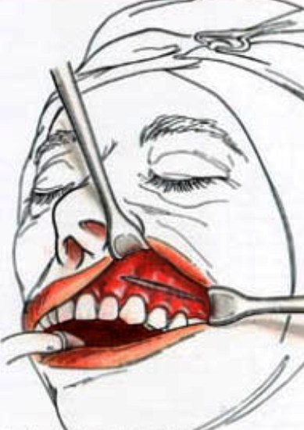
Sublabial Incision

Slide 13
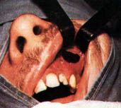
Hole made in anterior wall followed by Inferior Meatal Antrostomy

Slide 14
Ethmoid Sinusitis
Intranasal Ethmoidectomy
External Ethmoidectomy
- Lynch Howarth procedure
- Patterson transorbital procedure
- Jansen Horgan transantral procedure
FESS

Slide 15
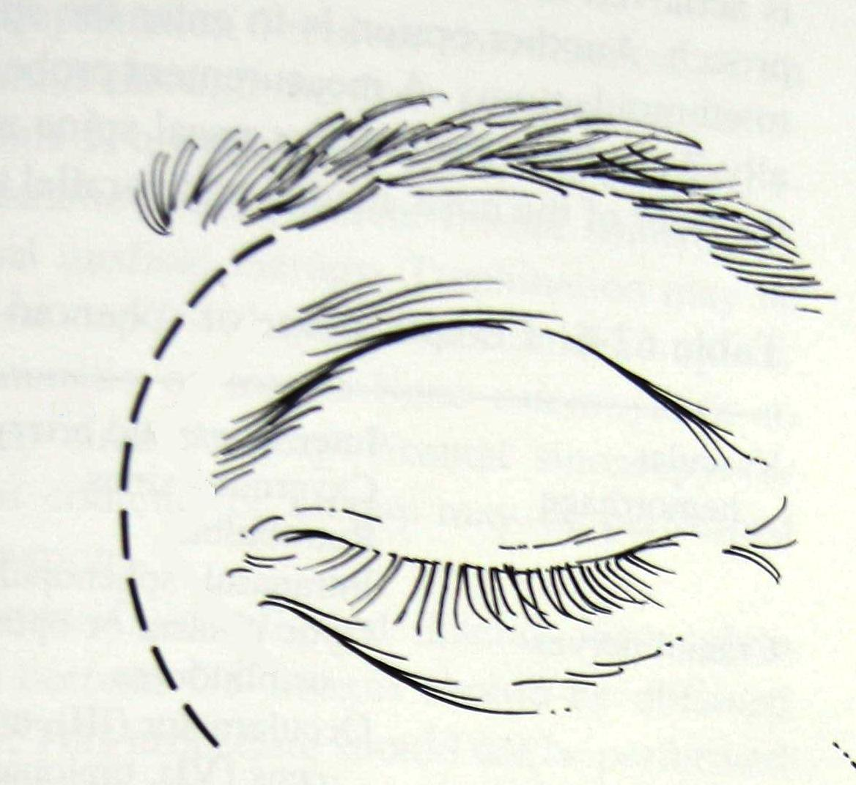
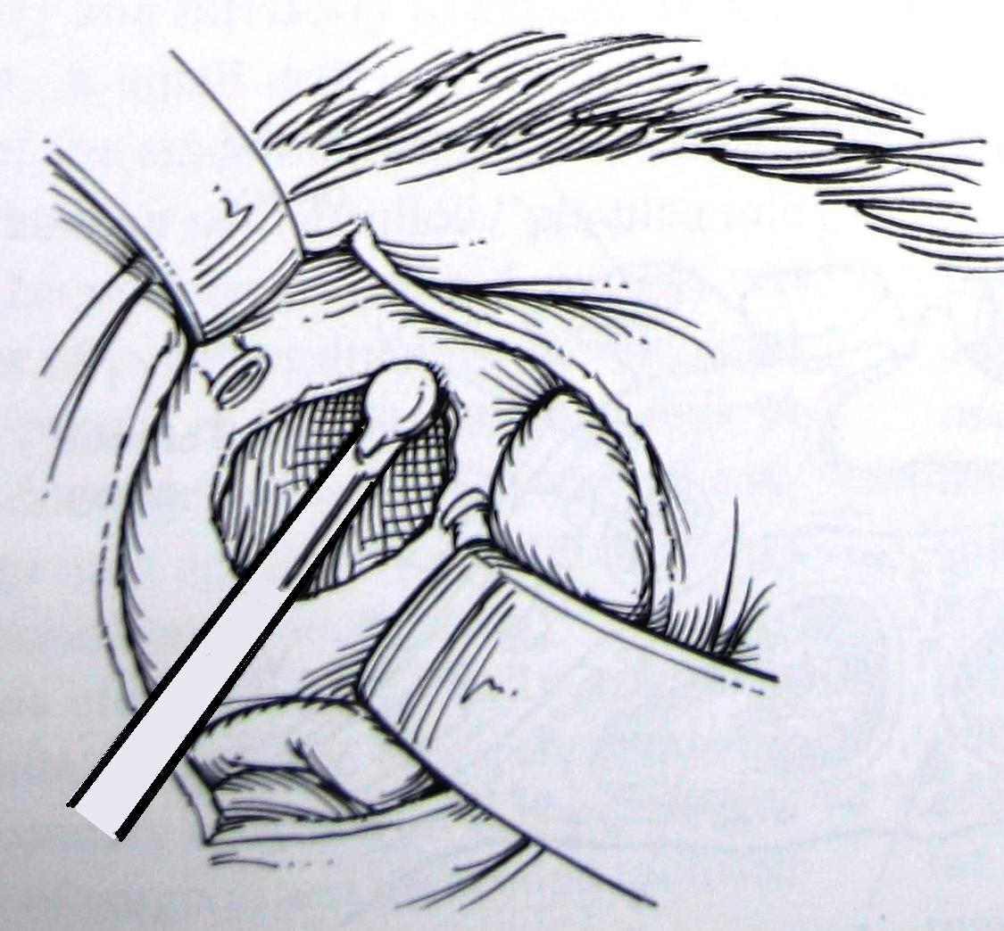
Lynch Howarth Ethmoidectomy

Slide 16
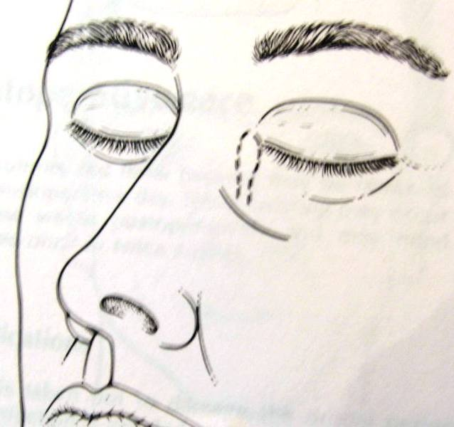
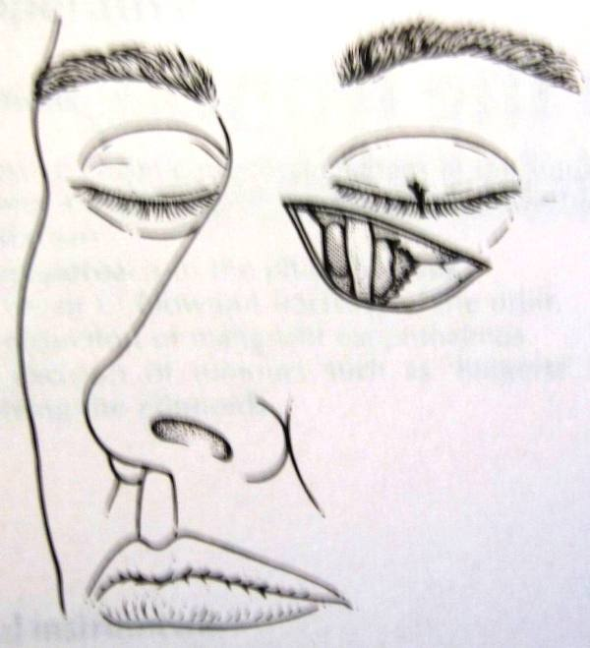
Patterson Ethmoidectomy

Slide 17
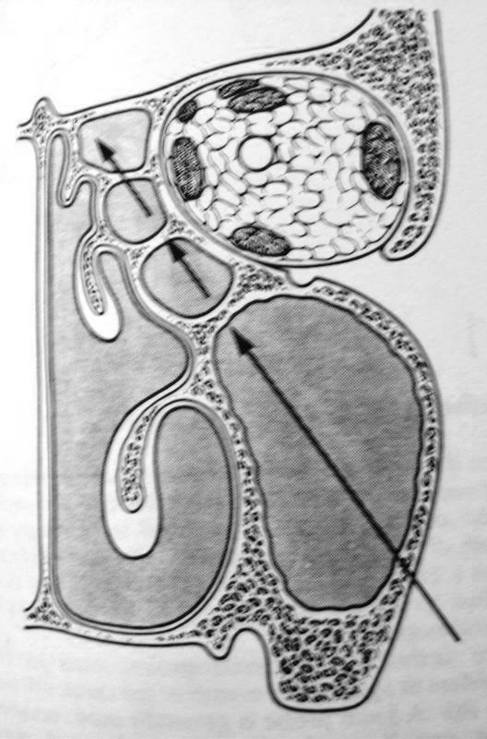
Trans-antral ethmoidectomy

Slide 18
Frontal Sinusitis
Trephination
Osteoplastic flap procedure
- Coronal incision
- Brow incision
FESS

Slide 19
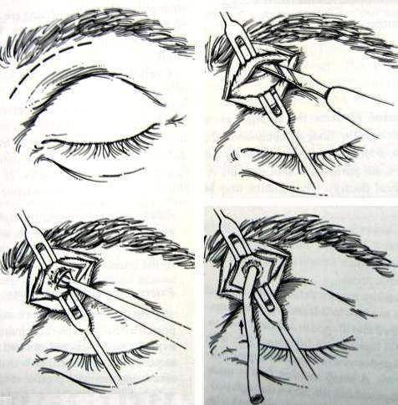
Frontal sinus trephination

Slide 20
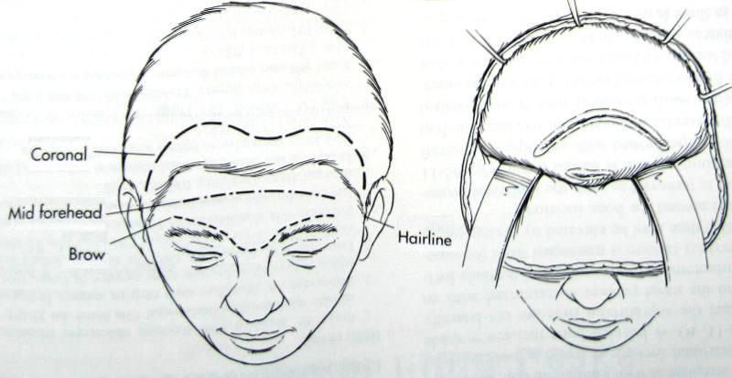
Osteoplastic flap procedure

Slide 21
Sphenoid Sinusitis
Trans-nasal trans-septal approach
Sublabial trans-septal approach
External ethmoidectomy approach
FESS

Slide 22
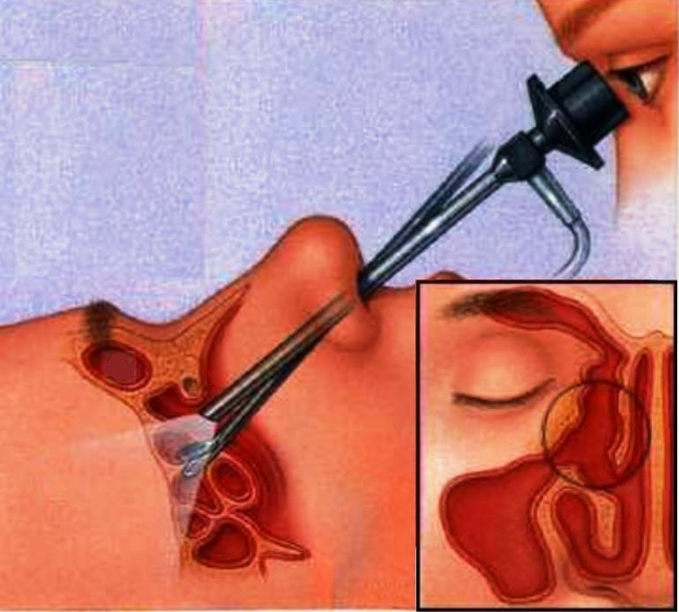
FESS
Indications
- Choronic sinusitis refractory to treatment
- Nasal polyps
- Fungal sinusitis
- Antro choanal polyp
- Fronto-ethmoidal mucocoele
- Repair of CSF leak
- DCR
- Orbital decompression

Slide 23
Functional Endoscopic Sinus Surgery
Uncinectomy (Infundibulotomy)
Bullectomy & Anterior ethmoidectomy
Middle meatal antrostomy
Perforation of basal lamella
Posterior ethmoidectomy
Sphenoid sinus exploration
Skull base disease clearance
Frontal recess exploration

