Slide 1
EPISTAXIS
Dr.smr.Azimi
Otorhinolaryngologist
Fellowship of rhinology

Slide 2
REASONS FOR EXCESSIVE BLEEDING
Vascularity of nose
Both external and internal carotids.
Anastomsis between arteries and veins.
Blood vessels run just under the mucosa-unprotected.
Larger vessels on the turbinate run in bony canals

Slide 3
LITTLE'S ( KIESSELBACH'S) AREA
1/2 inch from the caudal border of the septum antero-inferiorly
Vessels anastomosing are
Anterior ethmoid
greater palatine
Sphenopalatine
septal branch of superior labial
Bleeding may be arterial or venous.

Slide 4
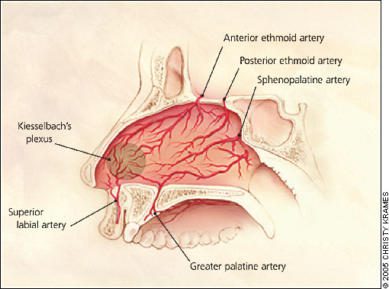
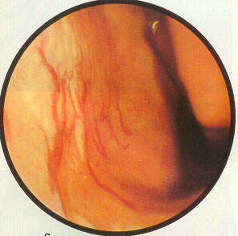
Blood supply of nose

Slide 5
CLASSIFICATION

Slide 6
I. According to site
Anterior
Superior; Anterior ethmoid
( bleeding is from above ant. half of middle turbinate)
Inferior; Greater palatine
Posterior; Sphenopalatine
(Bleeding is from below anterior half of middle turbinate)

Slide 7
II. PRIMARY & SECONDARY

Slide 8
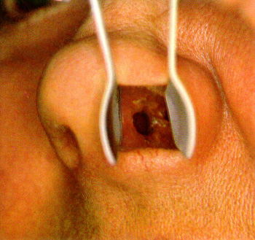
III. According to Etiology
Local Causes:
[1] Trauma
Nose picking,
fractures.

Slide 9
LOCAL CAUSES
[2] Infections:
Viral:Influenza, measles
Diphtheria
lupus vulgaris
leprosy
Parasites
fungal

Slide 10
LOCAL CAUSES
[3] Idiopathic:
Wegner's granulomatosis,
Osler-Weber-Rendau's syn.,
atrophic rhinitis

Slide 11
LOCAL CAUSES
[4] Neoplasms:
Of the
nose,
nasopharynx and
sinuses.
Carcinom of the Nasopharynx
Angiofibroma

Slide 12
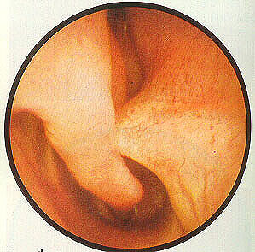
Local Causes
[4] Miscellaneous:
Septal spur,
foreign bodies

Slide 13
General Causes
Hypertension,
CCF
mitral stenosis
Cirrhosis
coagulopathies
purpura leukemias
Malignancies
Caissons' disease
Endometriosis
Nephritis
Typhoid

Slide 14
IV. According to Age
Children;
Foreign body, nose picking, nasal diphtheria
Adults:
Trauma, idiopathic
Middle age:
tumors
Old age:
hypertension

Slide 15
MANAGEMENT
I] Investigations:
CBC,
Bleeding profile, BT, CT, PT, APTT, Platelets
Hb

Slide 16
TREATMENT
First aid
Definitive treatment
Prevention of recurrences

Slide 17
FIRST AID
Make the patient sit up
pinch nose
open mouth and breath
Ice on forehead

Slide 18
DEFINITIVE TREATMENT
Assess blood loss
Crystalloids or colloids
Transfusion
Locate the point after packing the nose with 4% xylocaine and 1:1000 adrenaline mixture

Slide 19
CAUTERIZATION
1) Chemicals;
Silver Nitrate stick, chromic acid bead
2) Electrical
Apply ointment and advise against blowing and nose picking.

Slide 20
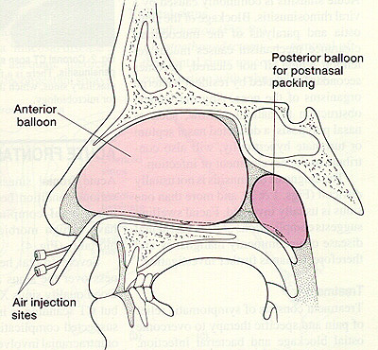
ANTERIOR PACKING
Unable to control bleeding
Ribbon, tampon
BIPP
(bismuth iodoform paraffin paste)
Polyfax

Slide 21
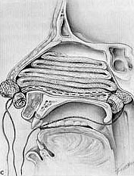

Slide 22
POSTERIOR PACKING
bleed is posterior
GA
Removed as soon as possible
Antibiotics
Foley's or other inflatable devices
Blood gases in children.

Slide 23
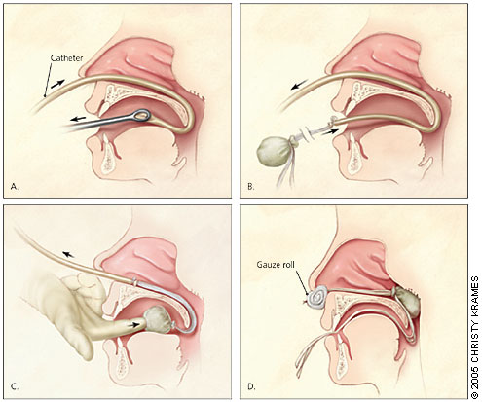
Post nasal packing

Slide 24
Complications
Infection
loose pack obstructing airway

Slide 25
SPECIAL CASES
Haemophilia;
Replace factor VIII, or fresh blood
Other clotting deficiency
FFP
Purpura;
Platelets
Anticoagulants;
Stop drug, or titrate.
Heparin is reversed with protamine
warfarin with vitamin K
Unconscious head injury;
Dangerous to pack in suspected skull base FX
Telengiectasia;
Septodermoplasty

Slide 26
OTHER TREATMENTS
Ligation of vessels
TESPAL
Maxillary artery
Ethmoid arteries
External Carotid artery

Slide 27
OTHER TREATMENTS
Embolization
Catheters with iced water lavage
52 degree water lavage
2% lignocaine and adrenaline injection in greater palatine foramen

