Slide 1
Choronic otitis media
Dr.smr.Azimi
Otorhinolaryngologist
Fellowship of rhinology

Slide 2
Chronic Otitis Media without Cholesteatoma
Acute or recurrent infection of the middle ear may result in a permanent perforation of the tympanic membrane
Ears with chronic perforations without cholesteatoma may be chronically or intermittently Infected.

Slide 3
symptoms
Chronic suppurative otitis media presents initially with chronic otorrhea(generally a mucopurulent discharge) through the nonintact tympanic membrane.
After the infection clears. the patient has few or no symptoms other than a variable degree of hearing loss
The recurrence of infection may cause pain. but this is not always present
Aural discharge reappears and may be creamy or mucopurulent in the presence of an acute infection
Chronic drainage
odorless, stringy mucus
fetid smell due to chronic infection with Pseudomonas or anaerobes.

Slide 4
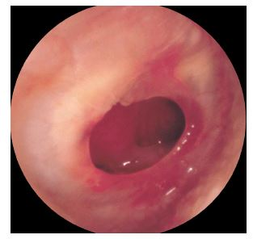
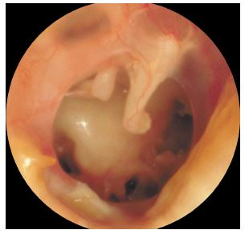
Chronic otitis media

Slide 5
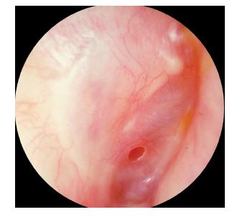
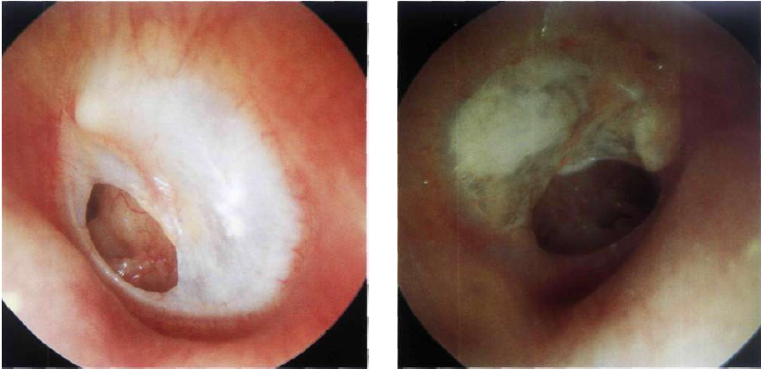

Slide 6
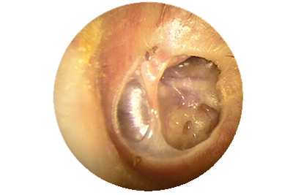

Slide 7
Diagnosis
Tympanic membrane perforation
AOM
chronic otitis media
trauma (injury or surgery)
Perforation of the tympanic membrane, especially involving the tympanic anulus, may allow ingrowth of the keratinizing epithelium of the ear canal or tympanic membrane, leading to cholesteatoma

Slide 8
An ear with a simple perforation may become infected
A simple perforation commonly is seen as a low-frequency conductive hearing loss clinically
The tympanic membrane velocity was found to be decreased in the low frequency in a small perforation and in the high and low frequencies in a large perforation

Slide 9
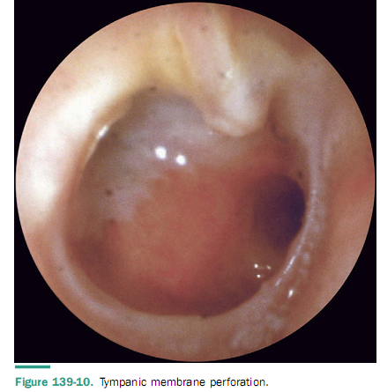

Slide 11
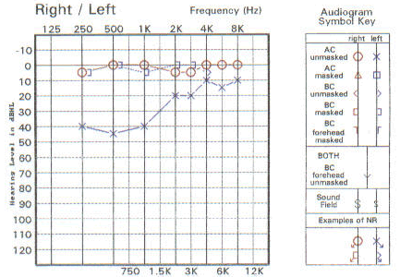

Slide 12
pathogensis
Chronic inflammation secondry to eustachian tube dysfunction
Genetic and constitutional factors that affect the healing capacity and resistance of the mucosa
Special anatomic characteristics of the middle ear spaces such as pneumatization and relative size
The nature,Pathogenicity,Virulence,and resistance of the infecting organisms

Slide 13
Management
Most infected perforations can be managed conservatively with topical antibiotics
Antibiotic otic suspensions
with or without steroids usually are effective
the antibiotics should be chosen to eradicate the most common pathogens, P. aeruginosa and S. aureus
In cases with recurrent or chronic infections, cultures should be used to adjust antibiotics

Slide 14
Potentially ototoxic topical preparations should be applied to the middle ear only when potential benefts outweigh the potential risks
Various agents have been used individually or in combination, including
boric acid
Sulfamethoxazole
chloramphenicol
hydrocortisone
Systemic antibiotics should be used in refractory cases when specifc pathogens are found on culture
Several quinolones such as ciprofoxacin, ofoxacin, and norfoxacin may be useful in these patients

Slide 15
In ears that become repeatedly infected but clear between episodes, tympanoplasty should be considered. Ideally, an ear with a tympanic membrane perforation should be free from infection for 3 months before tympanoplasty.
In some patients, chronic infection with otorrhea, but without cholesteatoma, persists despite aggressive medical therapy. In these cases, two options should be considered: long-term (6 to 8 weeks) intravenous antibiotics or tympanomastoid surgery

Slide 16
Chronic Otitis Media with Cholesteatoma
Aural cholesteatomas are epidermal inclusion cysts of the middle ear or mastoid
They contain the desquamated debris (principally keratin) from their keratinizing, squamous epithelial lining
Cholesteatomas of the temporal bone
congenital
acquired
Acquired cholesteatomas are the consequence of OME, AOM, or both.

Slide 17
Diagnosis
The diagnosis of aural cholesteatoma is made on otoscopic examination
CT& MRI (may be used to complement the clinical examination)
HRCT is useful for operative planning
The symptoms of cholesteatoma vary
asymptomatic
conductive hearing loss
malodorous otorrhea
Some patients have signs and symptoms of the complications of a cholesteatoma:
vertigo
hearing loss caused by a labyrinthine
fistula
facial nerve paralysis
intracranial infection.

Slide 18
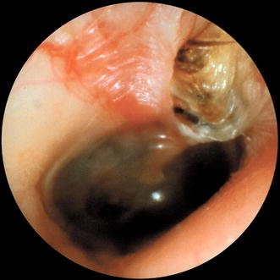
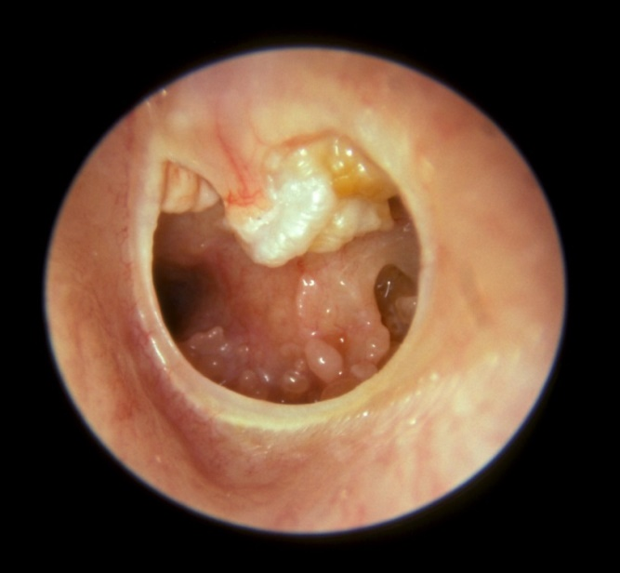
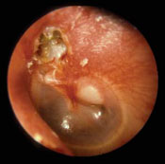
cholesteatoma

Slide 19
Pathogenesis
Congenital cholesteatomas, by defnition, originate from areas of keratinizing epithelium within the middle ear cleft
The pathogenesis of acquired cholesteatoma has been debated for more than a century. There are four basic theories of the pathogenesis of acquired aural cholesteatoma: (1) invagination of the tympanic membrane (retraction pocket cholesteatoma), (2) basal cell hyperplasia, (3) epithelial ingrowth through a perforation (the migration theory), and (4) squamous metaplasia of middle ear epithelium

Slide 20
Acquired cholestatoma
underlying Eustachian tube dysfunction that causes retraction of pars flaccida
keratinizing squamous epithelium has grown beyond its normal limits
A typical attic retraction cholesteatoma appears as a defect of variable size adjacent to the posterosuperior portion of the tympanic membrane in the region of the pars faccida with scutum erosion

Slide 21
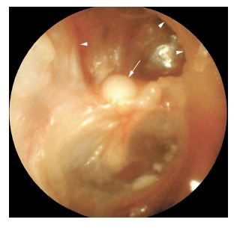
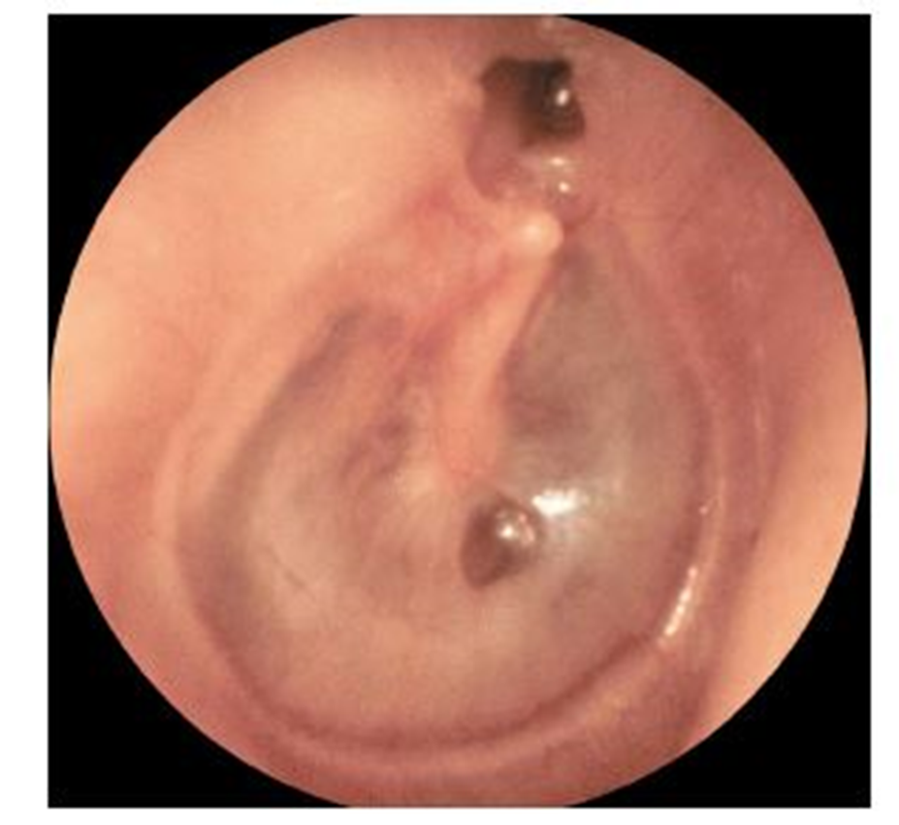

Slide 22
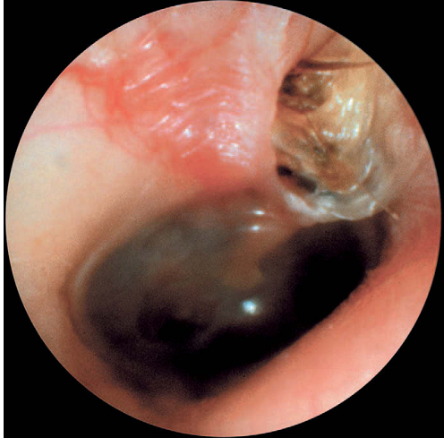

Slide 23
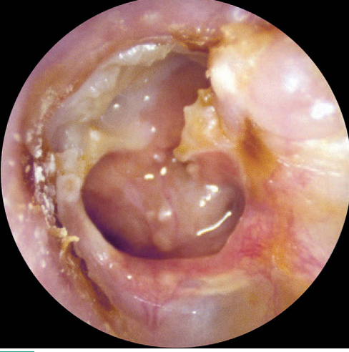
keratinizing epithelium has migrated through a perforation into the middle ear
(secondary acquired cholesteatoma)
The presence of an aural polyp in a chronically infected ear should be considered to be a cholesteatoma until proved otherwise

Slide 24
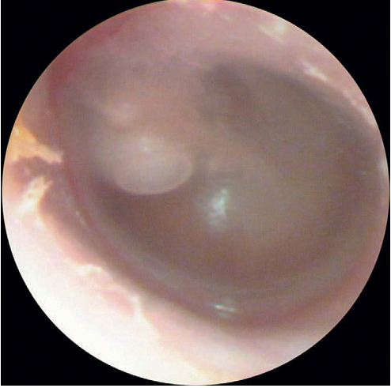

Slide 25
Congenital cholesteatoma
  behind an intact tympanic membrane
  White mass medial to normal tympanic membrane
  Normal pars flaccida and pars tensa
  No prior history of otorrhea or perforations
  No prior otologic procedures
  Prior bouts of otitis media were not grounds for exclusion as was the case in original definition

Slide 26
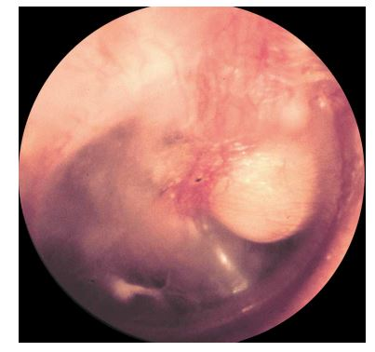
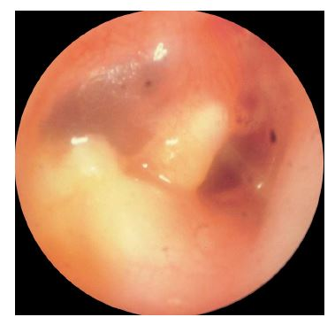
Congenital cholesteatoma

