Slide 1
Semiology in ENT Patient
dr_smr_azimi (otorhinolaringologist)

Slide 2
History
Chief complaint:
Ear? Nose? Throat? Neck?
Patients own words if possible
Notes:
The physician should address the patient’s chief complaint by
determining its duration, intensity, location, frequency, factors that
make the problem worse or better, any past therapy, and related symptoms.

Slide 3
History
History of present illness:
Location
Onset, frequency, duration, Intensity
Associated symptoms
Previous work-up, testing, imaging, Pathology specimens or interventions
What has the patient already tried?
Notes:
The physician should address the patient’s chief complaint by
determining its duration, intensity, location, frequency, factors that
make the problem worse or better, any past therapy, and related symptoms.

Slide 4
History
Past Medical History:
HTN? DM? HLP? IHD? Thyroid disease? Seizures?
Allergies? Asthma? Neurologic or rheumatologic disorders?
Past Surgical History: Head and neck procedures?
Allergies- Aspirin Sensitivity?
Social History: Addiction? Smoker? Alcohol use?
Acoustic trauma, Past irradiation
S
Sampter Triad:
Allergies + Asthma + Aspirin sensitivity
Notes:
For patients being assessed for hearing loss, major
risk factors such as exposure to machinery, loud music, or gunfire
should be discussed. Finally, past irradiation (implants, external beam,
or by mouth) and dosage (either high or low dose) should be ascertained.

Slide 5
ENT Review of Systems
Gen: fever/ chills/ weight changes
Ear: tinnitus/ vertigo/ hearing loss/ otalgia/ otorrhea
Nose: congestion/ rhinorrhea/ epistaxis/ hyposmia
Throat: pain/ dysphagia/ odynophagia
Larynx: hoarseness/ voice changes/ noisy breathing/ difficulty breathing / pain with speaking (odynophonia)
Trachea: noisy or difficulty breathing
Neck: lymphadenopathy/ new lumps or bumps/ pain/ swelling
Face: sinus pain/ pressure/ swelling/ numbness

Slide 6
Ear history
Right Ear:
Last episode of otorrhea
Tinnitus
Hearing loss
Otalgia
Otorrhea
History of previous operations
Left Ear:
Last episode of otorrhea
Tinnitus
Hearing loss
Otalgia
Otorrhea
History of previous operations
ABG
Vertigo

Slide 7
Tonsil history
Congestion
PND/ Rhinorrhea
Recurrent pharyngitis
Dysphagia/ odynophagia
FTT
Difficulty breathing
Mouth breathing
Snoring
ADHD
Hearing Loss
Otorrhea

Slide 8
Thyroid history
Hoarseness
Difficulty breathing
Heat and cold Intolerance

Slide 9
Initial Exam
First, start by looking at the skin of the face
Look for scars, any concerning lesions
Check for symmetry, is there muscle weakness?
Does the patient have tell-tale signs?
Nasal crease in allergies
Noisy nasal breathing?
Listen to the patient’s voice as they give the history/answer questions
Is it breathy? Nasal? Does the patient have stridor?

Slide 10
Physical Exam
Facial Skleton
periorbital rims
dorsum of the nose
Firmly palpate regions overlying the paranasal sinuses
temporomandibular joint (TMJ)

Slide 11
Parotid Gland
The tail of the parotid extends to the region lateral and inferior to the angle of the mandible, a common site for parotid masses to reside.
parotid-preauricular and retroauricular lymph nodes should be systematically assessed in every patient

Slide 12
Skin
All moles should be inspected for irregular borders, heterogeneous color, ulcerations, and satellite lesions.
The external auricles often receive sun exposure and are at risk for developing the skin malignancies

Slide 13
Neck
The midline structures such as the trachea and larynx can be easily located and then palpated for deviation or crepitus.
If there is a thyroid cartilage fracture, tenderness and crepitus may be present.

Slide 14
Thyroid
Resides below the cricoid cartilage
Thyroid gland should be examined by standing behind the patient and placing both hands on the paratracheal area near the cricoid cartilage.
Have the patient swallow or drink a sip of water
Pressing firmly in one tracheal groove allows the contents of the other side to be more easily distinguished by gentle palpation.

Slide 15
Triangles of the neck.

Slide 16
Face/Cranial Nerves
CN I – smell
CN II – visual field, acuity
Extraocular Muscles (CN III, IV, VI)
CN V
Bilateral sensation in all distributions (V1-V3)
Corneal reflex
Maseter muscles
CN VII
Asymmetry or weakness
CN VIII – hearing, nystagmus in lateral gaze, caloric test
CN X - palate rise, voice, gag
CN XI - shoulder shrug, head turn, gag
CN XII- tongue protrusion

Slide 17
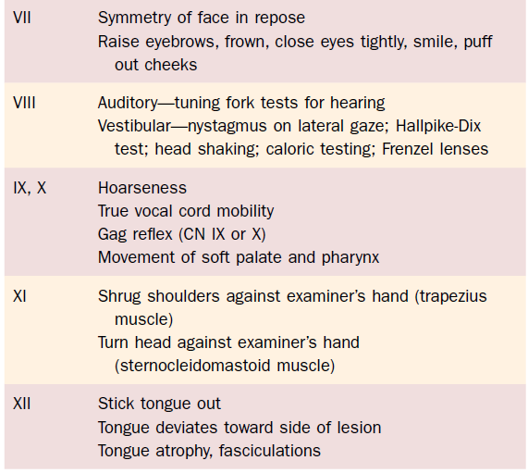

Slide 19
Be familiar with gear

Slide 20
External anatomy

Slide 21
Ears
External exam
Deformities? Preauricular pits? Ulcers or lesions?
Postauricular region
well-healed surgical incisions
In children, postauricular mastoid: subperiosteal abscess
head trauma, postauricular ecchymosis (or Battle’s sign), temporal bone fracture

Slide 22
Ears
External auricles: canal atresia, accessory auricles, microtia, and prominent protruding “bat ears.”
Edema, crusting otorrhea: signify an infection.
Hematoma: “cauliflower ear”
Maculopapular rash: herpes zoster
Notes:
anterior to the pinna, at the root of the helix, may have
preauricular pits or sinuses, which may become infected. The external
auricles also may show abnormalities or congenital malformations,
including canal atresia, accessory auricles, microtia, and prominent
protruding “bat ears.” The outer ears may have edema with weeping,
crusting otorrhea, which may signify an infection.

Slide 23
External Auditory Canal
When removing cerumen, remember two points:
Sensory fibers: CN V3, the auricular branch of CN X, C3, and CN VII.
To visualize the ear canal, gently grasp the pinna and elevate it upward and backward.
Cerumen impaction may be removed
careful curetting, gentle suctioning, or irrigation with warm water.
Notes:
The outer third (approximately 11 mm) of the auditory canal is cartilaginous.
The adnexa of the skin contain many sebaceous and apocrine
glands that produce cerumen. Hair follicles also are present. The inner
two thirds (approximately 24 mm) of the canal is osseous and has only
a thin layer of skin overlying the bone. Cerumen is commonly found
accumulating in the canal, often obstructing it. When removing
cerumen, remember two points. The canal is well supplied with sensory
fibers: first, CN V3, the auricular branch of CN X, C3, and CN VII.
Second, the canal curves in an S-shape toward the nose. To visualize
the ear canal, gently grasp the pinna and elevate it upward and backward.
This will open the external auditory canal and allow atraumatic
insertion of the otoscopic speculum. Cerumen impaction may be
removed with many techniques, such as careful curetting, gentle suctioning,
or irrigation with warm water.

Slide 24
External Auditory Canal cont.
Otitis externa, or “swimmer’s ear”
painful condition, an edematous, weeping external canal.
Granulation tissue at the junction of the cartilaginous and bony junction: osteomyelitis of the temporal bone “Malignant otitis externa”
Foreign body in children
Notes:
Otitis externa, or “swimmer’s ear,” is a painful condition with an
edematous, often weeping external canal. If severe, the entire canal may
be so edematous and inflamed that it closes, making inspection of the
tympanic membrane difficult. Gently tugging on the auricle is painful
for many patients. The periauricular lymph nodes may be tender and
enlarged. If the patient is immunocompromised or diabetic, the canal
should be carefully inspected for the presence of granulation tissue at
the junction of the cartilaginous and bony junction. This may signify
that a malignant otitis externa is present, which, as an osteomyelitis of
the temporal bone, requires aggressive management, including prompt
intravenous antibiotics.

Slide 25
External Auditory Canal cont.
Otorrhea characteristics:
Mucoid drainage: chronic suppurative otitis media
Foul-smelling otorrhea: suppurative otitis media with a cholesteatoma.
Bloody, mucopurulent: acute otitis media, trauma, or carcinoma
Watery Otorrhea: cerebrospinal fluid leak or eczema of the canal.
Black spores in the otorrhea: a fungal otitis externa caused by Aspergillus species.
Notes:
Foul-smelling otorrhea
may be caused by chronic suppurative otitis media with a cholesteatoma.

Slide 26
Ears
Otoscopy
Tympanic Membrane
Normal: Shiny, translucent, visible light reflex
Tympanosclerosis (white)
Erythema, bulging, dull, retractions
Perforations

Slide 27
Right ear. Normal tympanic membrane
1 = pars flaccida;
2 = short process of the malleus;
3 = handle of the malleus;
4 = umbo;
I = incus;
P = promontory;
A = annulus.
Notes:
Right ear. Normal tympanic
membrane. 1 = pars flaccida; 2 = short
process of the malleus; 3 = handle of the
malleus; 4 = umbo; 5 = supratubal recess;
6 = tubal orifice; 7 = hypotympanic air cells;
8 = stapedius tendon; c = chorda tympani;
I = incus; P = promontory; o = oval window;
R = round window; T = tensor tympani;
A = annulus.

Slide 28
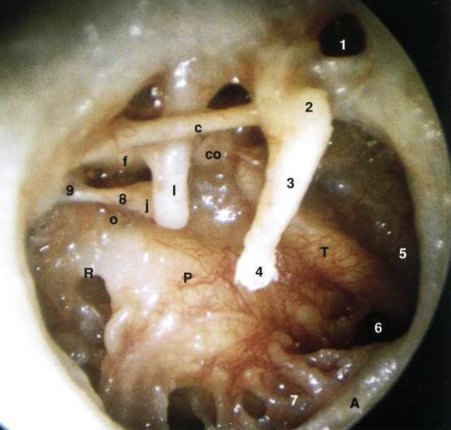
Right ear. Normal tympanic membrane
1 = pars flaccida;
2 = short process of the malleus;
3 = handle of the malleus;
I = incus; ; o = oval window;
R = round window
P = promontory;
A = annulus.
Notes:
Right ear. Structures of the
middle ear seen after removal of the tympanic
membrane. 9 = pyramidal eminence;
co = cochleariform process; f = facial nerve;
j = incudostapedial joint.

Slide 29
Right and left normal tm

Slide 30
Perforations
Central perforation
Marginal perforation

Slide 31
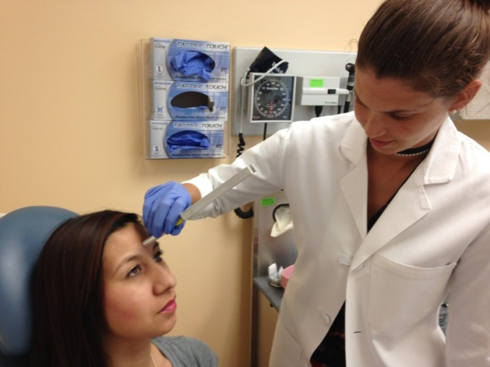
Ears
Tuning fork exam
Rinne: Air vs. bone conduction
Just outside to EAC vs. over mastoid
Normal: AC > BC
Weber: Tuning fork on top/center of head
Normal: equal on both sides
Does the sound lateralize?

Slide 32
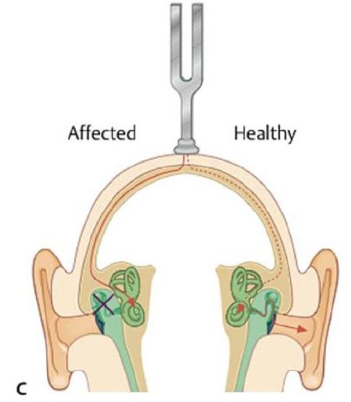
Weber test

Slide 34
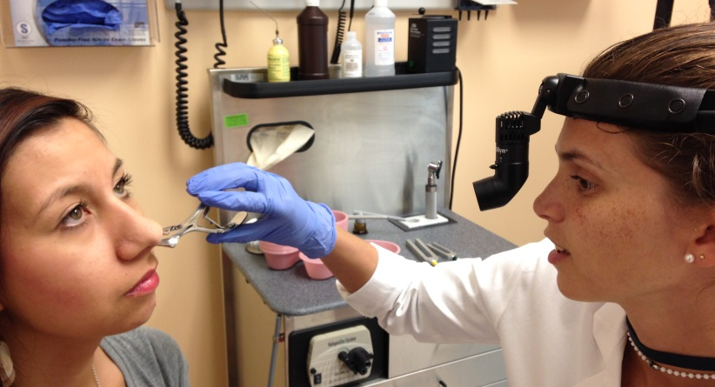
Nose
Eternal exam
Deformities, symmetry, size/patency of nares, transverse crease
Nasal speculum (anterior rhinoscopy)
Septum, inferior turbinates
Septal deviation, pale turbinates/ mucosa, hypertrophy of inferior turbinates, rhinorrhea, masses, prominent vessels

Slide 35
Mouth
Teeth, gums, alveolar ridge
Edentulous,
dentures (remove)
Mucosa
Buccal mucosa, palatal mucosa, lingual mucosa, vestibule (between teeth and lips)
Retromolar trigone
Retromolar trigone

Slide 36
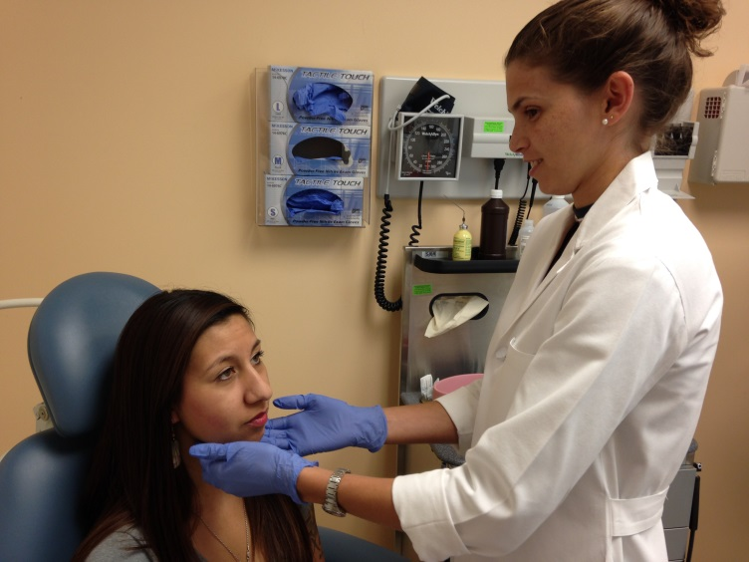
Salivary Glands
Palpate for masses, stones
Stenson’s duct (parotid gland opening on buccal mucosa)
Wharton’s duct (submandibular and sublingual gland, located on floor of mouth)

Slide 37
Oral Cavity & Oropharynx
Uvula: Bifid, Deviation, Large and inflamed
Tonsils
Enlarged, symmetry, exudates, masses, tonsilliths
Grading tonsils
1+ fills <25% of oropharynx between tonsillar pillars
2+ 25-50%
3+ 50-75%
4+ >75%
Posterior pharyngeal wall
Blood, Erythema, drainage, purulence, exudates
Notes:
The uvula should be inspected because a bifid structure may signify a submucosal cleft palate. In addition,
an inflamed large uvula may mean the uvula has been traumatized
during the night if the patient snores heavily.

Slide 38
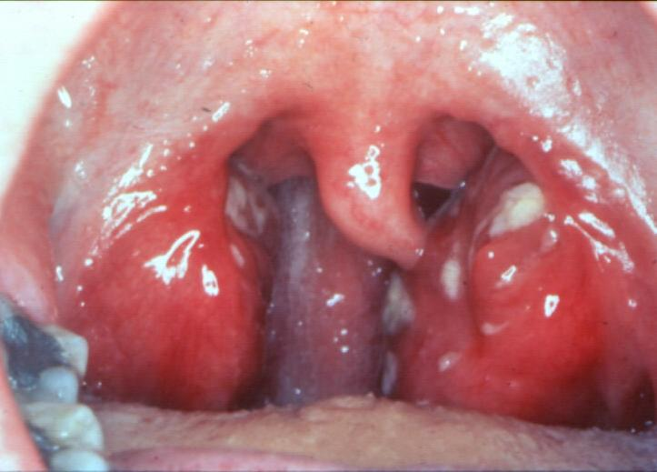

Slide 39
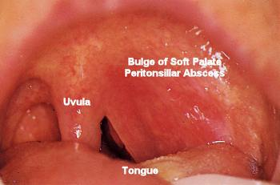

Slide 40
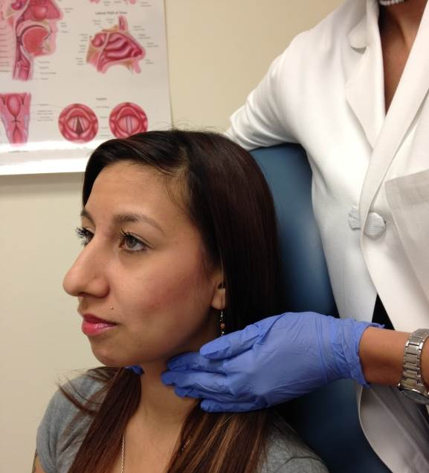
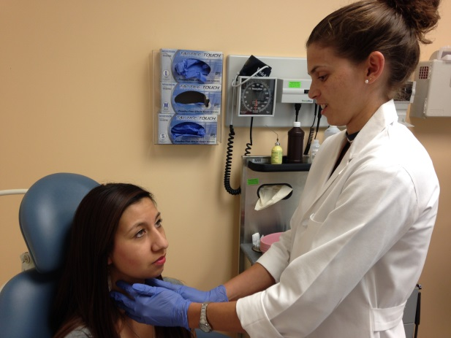
Neck
Lymphadenopathy
Thyroid
Masses
Exact location, size, mobility, depth, tenderness, texture, firmness, fluctuance
Larynx and trachea

Slide 41
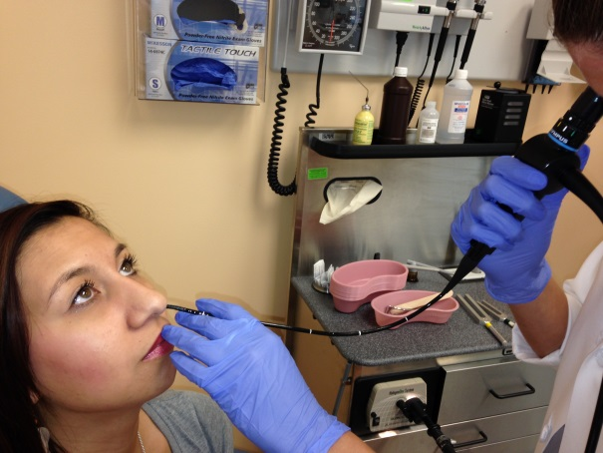
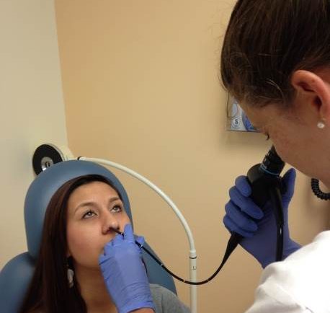
Fiberoptic Nasopharyngoscopy
What is it?
Exam of nasopharynx, oropharynx, hypopharynx, larynx
Use afrin/lidocaine before exam
Indications?
Voice changes, neck masses, shortness of breath/noisy breathing, concern for mass from nose down to larynx

Slide 42
View of larynx
Tongue base
Vallecula
Epiglottis
False vocal cord
True Vocal cord
Piriform fossa
Arytenoid cartilage

