Slide 1
Foreign Bodies of the Airway

Slide 2
Epidemiology
Most deaths occur before hospital intervention
Most airway foreign body aspirations occur in patients younger than 15 years old
The highest incidence occurs between 1 and 3 years of age; 25% of patients are younger than 1 year

Slide 3
The reasons toddlers are most susceptible
they lack molars necessary for proper grinding of food
they have less-controlled coordination of swallowing, and immaturity in laryngeal elevation and glottic closure
there is an age-related tendency to explore the environment by placing objects in the mouth
they are often running or playing at the time of ingestion
Older children and adolescents may have an
anatomic abnormality or a neurologic impairment.

Slide 4
Accidental aspiration or ingestion of objects tends to be twice as common in boys
Vegetable matter is seen in approximately 70% to 80% of airway foreign body ingestion
the most common are
peanuts in the United States
watermelon seeds in Egypt
pumpkin seeds in Greece.

Slide 5
Plastic pieces constitute approximately 5% to 15% of airway foreign bodies
➔plastic pieces tend to remain longer because they are inert and radiolucent
The most common esophageal foreign bodies are coins (75% of cases)
Meat and vegetable matter impactions are less common in children

Slide 6
Location
Most airway foreign bodies become lodged in the bronchi because
size
confguration
allow passage through the larynx and trachea
Bronchial foreign bodies are more common in the right main bronchus in adults
Larger objects become impacted in the larynx or trachea, sometimes causing complete obstruction, which is an acute emergency

Slide 7
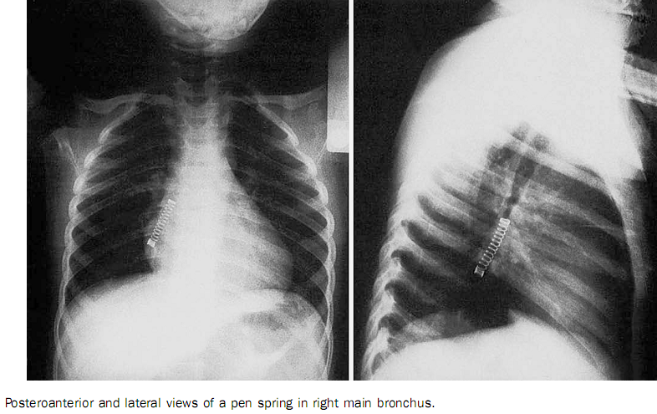

Slide 8
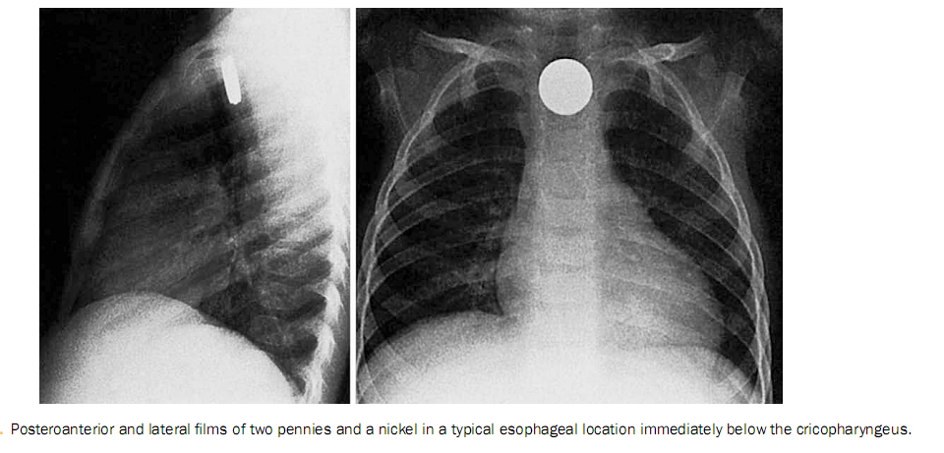

Slide 9
Acute Airway Obstruction
Complete airway obstruction resulting from a foreign body is an absolute emergency
partial obstruction
Coughing
gagging
Older children and adults may signal choking by grasping the neck

Slide 10
For infants, rescue breaths and chest compressions are recommended
Children older than 1 year require gentle abdominal thrusts while supine
Older children and adults are positioned standing, sitting, or recumbent for the Heimlich maneuver
not recommended
Back blows or abdominal thrusts in individuals with only partial obstructions could lead to complete obstruction

Slide 11
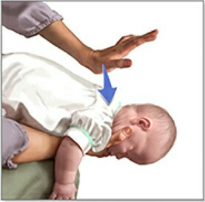
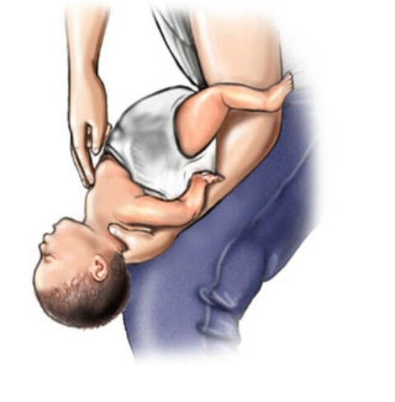

Slide 12
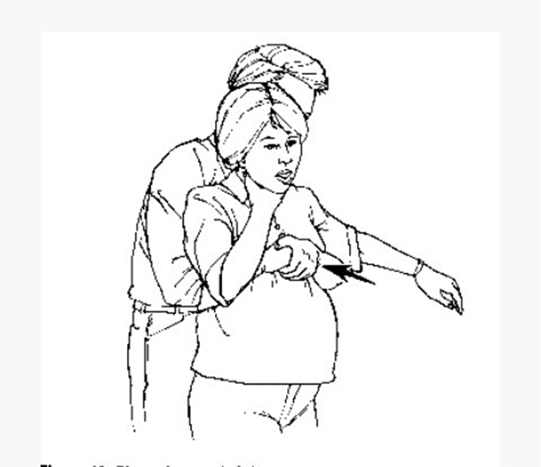
Heimlich maneuver

Slide 14
Symptoms
Foreign body aspiration is suspected when a victim has acute choking or severe coughing with respiratory distress
Symptoms of foreign body aspiration can mimic conditions such as asthma, croup, and pneumonia
Onset of wheezing in an otherwise healthy child should prompt suspicion of foreign body aspiration.

Slide 15
Laryngeal Foreign Bodies
Irregular foreign bodies
sagittal plane orientation
may produce only partial obstruction, allowing adequate air movement around the obstruction
Resulting laryngeal edema can lead to complete obstruction
Typically, these patients have symptoms of obstruction and hoarseness
Some symptoms can mimic croup

Slide 16
Tracheal Foreign Bodies
patients with tracheal foreign bodies are seen in similar fashion, but typically do not have hoarseness
Jackson triad of tracheal foreign bodies:
asthmatoid wheeze
audible slap ➔ foreign body contact with the trachea
palpable thud➔ over the trachea
As with laryngeal foreign bodies, edema can progress to complete obstruction.

Slide 17
Bronchial Foreign Bodies
triad
Cough
wheezing
decreased breath sounds
Sudden onset of wheezing (especially if unilateralis) particularly suggestive of a bronchial foreign body
Occasionally, bronchial foreign bodies can cause respiratory compromise as a result of swelling of dried vegetable matter (e.g., dried beans and peas) or edema around the object, producing complete obstruction and lobar collapse.

Slide 18
Check valve
Ball valve
Stop valve

Slide 19
Radiographic Evaluation
Airway flms—high-kilovolt posteroanterior and lateral soft tissue radiographs of the neck—are the radiographic examination of choice to identify laryngeal and tracheal foreign bodies.
Chest radiographs are ordered before intervention.
Neck flms may show subglottic narrowing.

Slide 20
Bronchial Foreign Bodies
Children with bronchial foreign bodies can be radiographically normal or may show obstructive emphysema (air trapping) and atelectasis or consolidation (late fndings).
Even if the diagnosis is strongly suspected by history and physical examination, posteroanterior and lateral chest radiographs are performed.

Slide 21
Small objects may cause no radiographic abnormalities.
Foreign bodies that obstruct mainly on expiration generate a check-valve effect, resulting in hyperinflation of the affected side and mediastinal shift to the opposite side

Slide 22
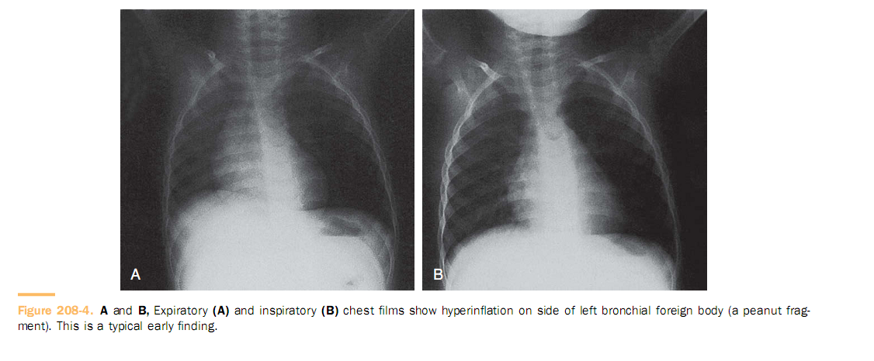

Slide 23
A ball-valve effect is produced later when
foreign bodies obstruct on inspiration and open on expiration, producing atelectasis on the affected side and a mediastinal shift toward the affected side

Slide 24
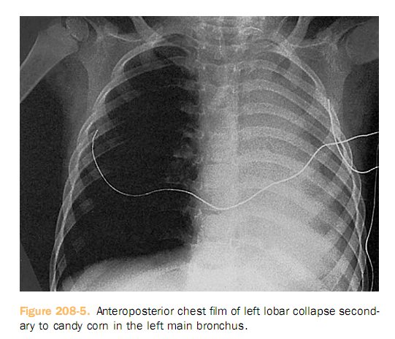

Slide 25
In younger children who cannot cooperate, lateral decubitus films may help.
Fluoroscopic evaluation is of little beneft; decreased diaphragmatic movement on the side of the obstruction is helpful in only 50% of cases.
Simultaneous biplane fluoroscopy is used for extraction of radiopaque foreign bodies in the lung periphery.

Slide 26
Management
Patients in respiratory distress are given support until the endoscopy team can safely attempt removal.
This support may include oxygen, heliox,or intubation.

Slide 27
choice For removal → rigid bronchoscopy
Flexible brochoscopy:
Pripheral aspiration
Unable neck extention

Slide 28
compliction
Immidiate:
Penumomediasten
Larngeal impaction
Unable to removal foreign body
Recovery room: bronchial spasm&laryngeal edema
Late:
Penumonia
Atelectasia
granuloma

