Slide 1
LARYNGEAL INFECTIONS
Dr.smr.Azimi
Otorhinolaryngologist
Fellowship of rhinology

Slide 2
Laryngitis
inflammatory condition of the larynx
Infectious laryngitis
Viral ➔ most common
bacterial
Mycobacterial
Fungal
protozoan organisms
children with airway symptoms
adults more commonly present with hoarseness and pain

Slide 3
Viral laryngitis
erythema and edema of the vocal folds
Agents include those causing URIs, with Rhinovirus being most common.
Treatment is symptomatic, as this should be a self-limited disease
-Therapy includes
voice rest
hydration
humidification
cough suppressant
expectorants

Slide 4
Croup (laryngotracheitis)
M/F = 2
Age: 6mo – 3yr
This illness is seen primarily in Late autumn and winter
Transmission: by direct contact and exposure to nasopharyngeal secretion
Incubation: 2- 6 day/shedding: up to 2 week
Parainfluenza viruses 1 and 2 and influenza A are the most common etiologic agents.

Slide 5
Clinical Features
The severity of the illness varies widely and is based on the degree of Vocal folds & subglottic edema
Prodromal nasal symptom
Low grade fever
Triad: 1- Barcking cough
2- Hoarsness
3- Stridor (Inspiratory)
Crucial Factor: airway obstruction

Slide 6
Parameters in airway obstruction
Stridor (inspiratory Vs.expiratory)
RR
Chest retraction
Decreased chest auscultation
Restlessness/Anxiety
Level of consciousness
Color or cyanosis
Oxygen desat.(pulse oximetry)

Slide 7
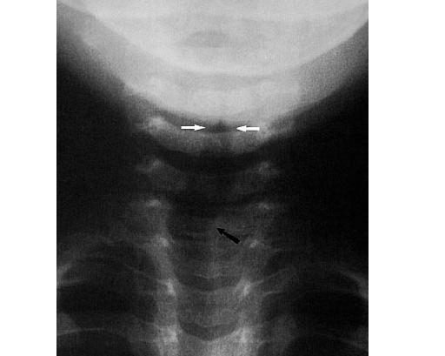
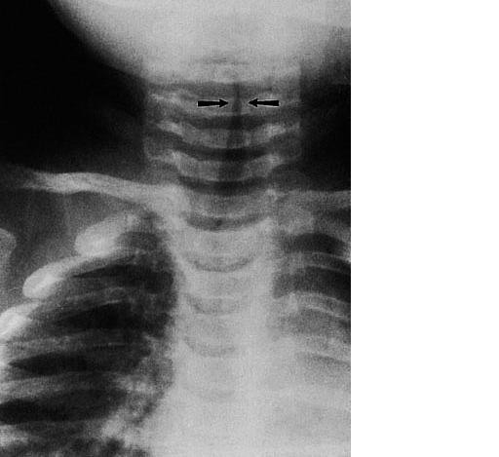
Radiology➔AP: Steeple sign (inverted V,pencilling)

Slide 8
Differential Diagnosis
Supraglottitis
Bacterial superinfection
Subglottic Hemangioma/stenosis
Foreign body
GERD

Slide 9
Spasmodic Croup
Sudden onset of stridor
Usually at night
In healthy child (no concomitant UAI)
Resolves spontaneously (several hours)
In allergic or psycho neurogenic basis

Slide 10
TREATMENT
Humidification or steam shower although this is not evidence-based
Racemic epinephrine may be useful to those children with respiratory distress, serving to decrease airway edema rapidly(within 10 – 30 min/ disappears by 2 hours)
Corticosteroids have a clear role in treatment of this condition (at least 3 hours latency) Decreased endothlial permeability
Airway intervention including intubation(5 – 7 day ) , tracheotomy may be necessary if
respiratory fatigue
hypercarbia
inadequate oxygenation
worsening neurologic status
For intubated children, an air leak should develop and indicate extubation potential, usually within 2 or 3 days
Endoscopic Evaluation: For atypical and recurrent cases, 3 – 4 week later

Slide 11
Bacterial laryngitis
is far less common than viral etiologies
Supraglottitis may involve the entire supraglottis or, more focally, the epiglottis (epiglottitis)
Edema of lingual surface of epiglottis leads to posteroinferior curl of it
The incidence of epiglottitis in children has dramatically fallen due to the Haemophilus influenzae type B vaccine (%95 decline)

Slide 12
Clinical Feature
Rapid progression in hours: life – threatening emergency
drooling
High fever
Difficult breathing
Muffled voice
Sever throat pain
tripod position
torso leaning partially forward
arms positioned at the sides just in front of the torso
neck extended
Cough and hoarseness is not present
Stridor: occurs in late phase (almost complete obstruction)

Slide 13
Tripod position

Slide 14
Diagnosis
erythematous epiglottis or supraglottis on flexible laryngoscopy in operating room
as manipulation of the airway with flexible endoscopy may precipitate airway compromise
lateral neck film and a “thumbprint” sign representing a swollen epiglottis &thickened AEF
DD: 1- Croup
2- Foreign body
3- Retro pharyngeal abscess

Slide 16
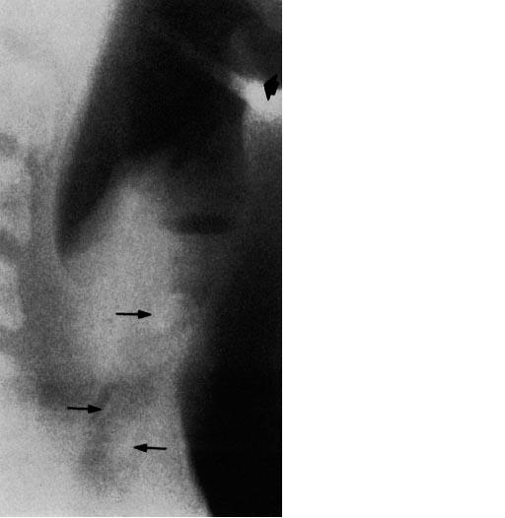
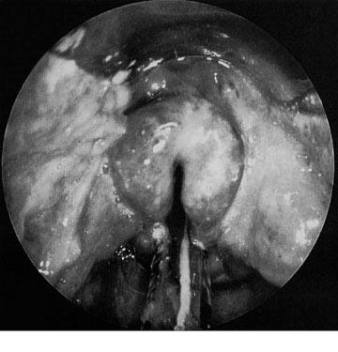
Radiology

Slide 17
Treatment
Avoid stimulate child
antibiotics that cover β-lactamase-producing H. influenzae, second- or third-generation cephalosporin (vancomycine in sensitive cases)
Corticosteroids
Intubation (48 – 72 hours) + culture
Epiglottis abscess is a rare complication of supraglottitis

Slide 18
Fungal Laryngitis
more commonly in the immunocompromised patient
may be seen in many varied patient populations
Candida sp. are the most common organisms
Systemic antifungal agents appropriate for the causative fungal organism are necessary
Topical antifungal medications are not curative, as they require direct contact with the organism, and the larynx is protected from exposure through protective-airway mechanisms

Slide 19
Tuberculosis
The larynx typically is edematous and hyperemic in its posterior third, with some exophytic granular areas
Biopsy, chest radiography, and sputum cultures may be necessary for diagnosis
Treatment is with antimycobacterial drugs, with cultures helpful given the significant drug resistance that may be present

Slide 20
Differential Diagnosis of laryngeal infection
Laryngeal neoplasm •
Airway foreign body •
Autoimmune diseases •
Allergic reaction •
Angioneurotic edema •
Subglottic stenosis •
Laryngopharyngeal reflux

Slide 21
Bacterial Tracheitis
Etiology:
Moraxella catarrhalis
staphylococus aureus
Pathophysiology
Secondary to viral croup: prodromal period
Primarily infection: rapid onset
Clinical Features
Typical croup that precedes the rapid & dramatic onset of high fever, respiratory distress and toxic appearance
Rapid onset of illness similar to supraglotittis but without dysphagia/drooling

Slide 22
Findings:
1- Cough
2- Stridor
3- High fever
4- Respiratory distress not respond to epinephrine
Usually there is no dysphagia/drooling
DL: Diagnostic & Therapeutic
Radiology:
1- AP: Steeple sign
2- Lat (Most helpful): Diffuse haziness &
Soft – tissue irregularity
in trachea

Slide 23
Management
Endoscopy and intubation
Vancomycine + ceftriaxone
Extubation:
1- air leak
2- decreased fever
3- decreased secretion

Slide 24
Retropharyngeal Abcess
Etiology :
Mixed aerobic and anaerobic (Staph/HI/Bacteroid/Peptococus)
Gram negative in neonates
M/F = 2/1
Early childhood: %50 < 3yr
%10 < 1mo
Location: Skull base to T6 between buccopharyngeal and prevertebral fascia
Two vertical paramedian LN chain that undergo atrophy by puberty
Cause of infection:
1- Pharyngitis
2- Osteomyelitis
3- Dental procedure

Slide 25
Clinical Features
After UAI infection slowly progression to:
- Fever
- Sore throat
- Progressive dysphagia/drooling
- Neck stiffness/torticollis
- Cervical adenopathy
- Asymmetric swelling in posterolateral pharyngeal wall

Slide 26
Radiology
1- Lateral neck: (soft – tissue/extension/inspiration)
Retropharyngeal space at C2 level is twice the vertebral body diameter
C2>7mm
C6>14mm in infant
C6>21mm in adult
2- CTscan with contrast:
Phlegmon: Round/central hypodense without ring enhancement
Abscess: Irregular or scalloped wall with ring enhancement

Slide 27
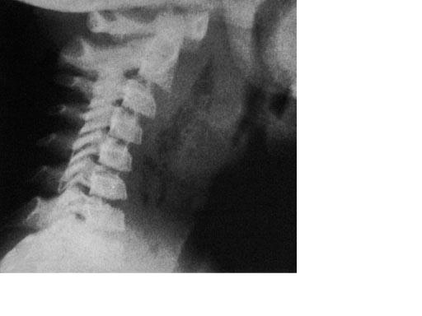
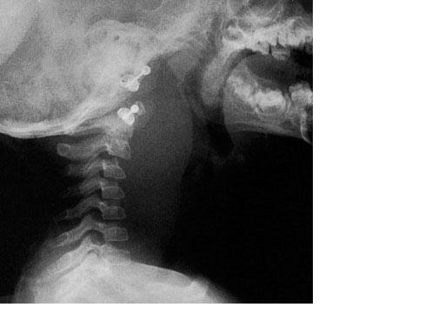
Radiology

Slide 28
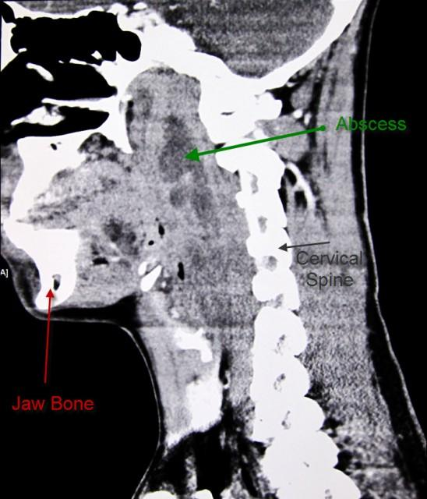

Slide 29
Management
1- Cellulitis: IV antibiotic
2- Abscess: surgical drainage
Intubation if needed

Slide 30
