Slide 1
Neck Trauma
Dr.smr.Azimi
Otorhinolaryngologist
Fellowship of rhinology

Slide 2
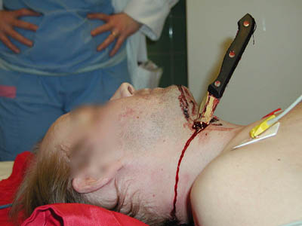

Slide 3
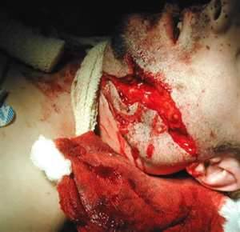

Slide 4
Types of injury
penetrating
rifle
low velocity
High velocity
Shotguns
knife
Blunt
Cloths line
Strangulation
whiplash

Slide 5
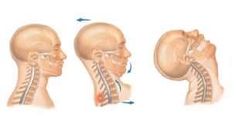

Slide 6
1. military rifles have a muzzle velocity of 760 m/s.
Highvelocity missiles (>610 m/s) not only tear tissue but transmit energy to surrounding tissue. A cavity of up to 30 times the size of the missile may be created
2. civilan handgun➔ low velocity (90 [m/s))

Slide 7
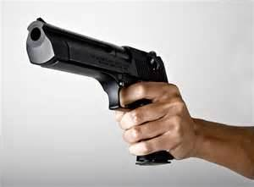
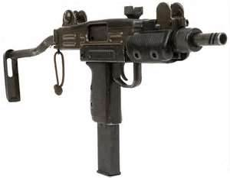
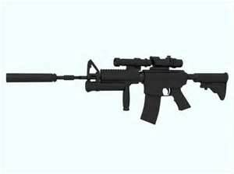

Slide 8
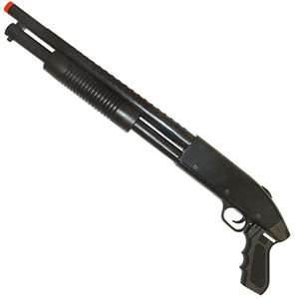

Slide 9
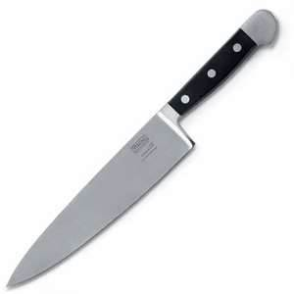
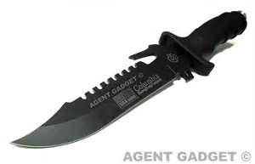

Slide 11
The mortality from all high-velocity rifle injuries inflicted direction the neck is significant. These patients usually do not survive and are not available for study
all known victims of high-velocity rifle injuries who survive on reaching the hospital merit strong consideration for surgical exploration
For stable patients, ➔angiograms should be considered before surgery.
In helping to determine if mandatory surgical exploration or preoperative diagnostic tests are necessary, knowledge of the size and velocity of the intruding missile is helpful.

Slide 12
Shotguns
The severity of shotgun wounds is largely dependent on the
distance between the weapon and the victim
the type of weapon used
the size of the projectile (shot)
At close range the entire charge can act like a ➔single missile similar to a high-velocity bullet.
At further distances,
birdshot pellets scatter and act as multiple individual missiles.
With larger pellets such as buckshot
significant injuries can occur from individual pellets up to 150 yards away with a standard-length barrel
Shotguns are low-velocity weapons (muzzle velocity of 300 m/s).

Slide 13
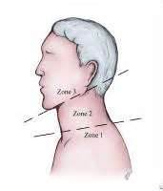

Slide 16
Diagnostic Evaluation
When the patient's stability allows
history
physical examination
( full examination of the unclothed body to look for entrance or exit wounds should be performed)
All patients should be managed assuming potential cervical spine fractures

Slide 17
In the conscious patient➔
a full neurologic examination should be done
and a chest radiograph taken
The radiograph should be examined to rule out hemothorax, pneumothorax, pneumomediastinum
Subclavian vessel injury may be first recognized by an abnormal chest radiograp
On radiographs, all cutaneous wounds can be marked with radiopaque objects to aid in evaluating the site of the injury.

Slide 18
Most trauma centers suggest that
personnel and equipment be available 24 hours a day for flexible endoscopy or arteriography
A hospital trauma team should include an otolaryngologist as part of the surgical team to help evaluate and repair the aerodigestive tract and explore the nerves and branches of the carotid artery in the neck
Patients with significant bleeding or an expanding hematoma need immediate attention with probable emergent exploration in the operating room

Slide 21
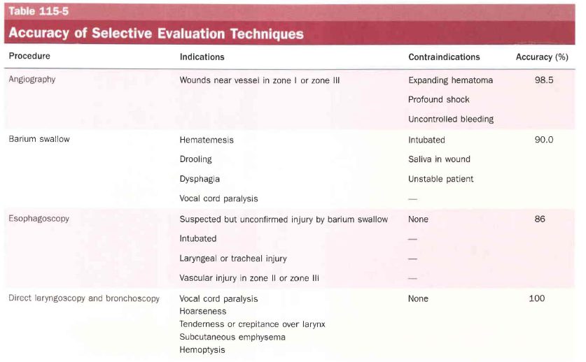

Slide 22
Management of Vascular Penetration
Zone Ӏ vascular perforation requires➔ thoracic surgery
( mediastinom extension or a formal lateral thoracotomy may be necessary)
Although a low cervical incision may result in sufficient exposure
Zone III injuries at the skull base can be temporized by pressure
A temporary arterial bypass of the carotid artery may be placed until the lacerated or aneurysmatic vessel can be approached safely

Slide 23
managment
Veins
All veins in the neck can be safely ligated to conttol hemorrhage;
(if both internal jugular veins are imerrupted by the injury, an anempt to repair one is appropriate.)
arteries
All external carotid artery injuries are easily managed by ligation because collateral circulation is good.
Common carotid or internal carotid injury in zone II is explored
Ligation of the common or internal carotid injuries is generally reserved for
irreparable injuries
profound coma state with bilateral fixed and dilated pupils
In areas of difficult vascular access at the skull base, detachable balloons or steel coils can be placed for carotid occlusion.

Slide 25
Delayed complications from unrepaired vascular injuries ➔
aneurysm formation
dissecting aneurysm
arteriovenous fistulas
Penetrating injuries in zone III have a higher incidence of multiple vascular injuries involving the
internal carotid artery
internal maxillary artery
external carotid artery

Slide 26
Digestive Tract
In the patient with a possible esophageal perforation, most radiologists recommend Gastrografin swallow as a first-order contrast study
because barium extravasation radiographically distorts soft tissue planes for other studies and is more toxic.
A negative Gastrografin study should be followed by a barium swallow if suspicion remains high

Slide 27
Many studies report the use of flexible esophagoscopy to circumvent the need for general anesthesia during rigid endoscopy
Missed esophageal tears represent most of the delayed injuries and, when they progress to mediastinitis, morbidity and mortality are considerable.
Some surgery services mandate neck exploration for patients who have air in the soft tissues of the neck despite yielding normal endoscopy results.

Slide 28
Many surgeons perform direct laryngoscopy, bronchoscopy, and rigid esophagoscopy under anesthesia for penetrating injuries of the neck with
air in the soft tissues
hemoptysis
hematemesis
In the setting of a cervical spine fracture, rigid esophagoscopy may have to be omitted.
Frequent monitoring of
vital signs
examination of the neck
the entry wounds
by the nursing staff, is also crucial.

Slide 29
A 48- to 72-hour observation period should be used to monitor for changes in
physical findings
vital signs
that mandate urgent attention.
Most vascular injuries that need attention present within 48 hours
the patient with
a negative physical examination
normal radiograph
endoscopy
will most likely have a negative neck exploration, and no significant injury will be discovered.

