Slide 1
Oral mucosal lesions
Dr.smr.Azimi
Otorhinolaryngologist
Fellowship of rhinology

Slide 2
RED/WHITE LESIONS
Red and white lesions represent a unique category of lesions that comprises a variety of entities.

Slide 3
Leukoedema
diffuse and generalized milky opacification that chiefly involves the buccal Mucosa
it is present in the majority of black adults
in nearly half of black children
as a Cannabis-related side effect
in tobacco users
The distribution tends to be symmetric and involves the buccal Mucosa and, to a lesser extent, the labial mucosa
The appearance may be that of a diffuse, filmy grayish surface with white Streaks, wrinkles, folds, or milky alteration.

Slide 4
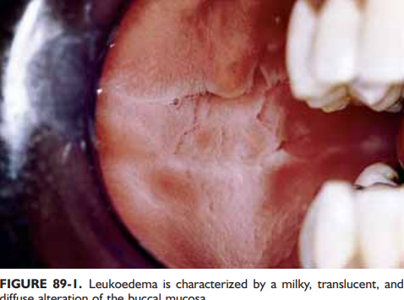

Slide 5
Ddx:
leukoplakia
hyperkeratotic conditions
white sponge nevus
homogeneous form of lichen planus
hereditary benign intraepithelial dyskeratosis

Slide 6
Management:
this particular mucosal alteration does not require treatment, because it is totally benign
there have been no reported cases of dysplastic alteration or transformation to carcinoma

Slide 7
ORAL LEUKOPLAKIA
a white patch or plaque
the most common premalignant oral mucosal lesion; however, most cases are
benign and remain so over time
variable clinical pattern
a thin, grayish surface alteration that demonstrates a white translucent quality with ill-defined margins and generally smooth surface qualities
sharply marginated, thick and opaque plaques
.

Slide 9
Treatment
associated histologic findings obtained by incisional biopsy
Benign or minimally dysplastic lesions ➔periodic simple observation or excision
premalignant
Malignant
Complete removal of these lesions can be accomplished by a wide array of modalities that include scalpel excision, laser ablation, electrocautery, or cryoablation

Slide 10
HAIRY LEUKOPLAKIA
asymptomatic white lesion
characteristically arises along the lateral tongue margins bilaterally
Related to systemic immunosuppression
the etiologic agent : epstein-barr virus (EBV)
confirmation of a viral process:
in situ hybridization, southern blot procedure, polymerase chain reaction, or ultrastructural demonstration of virus
ranging from subtle white keratotic vertical streaks to thick
corrugated and then to shaggy surface alterations.

Slide 11
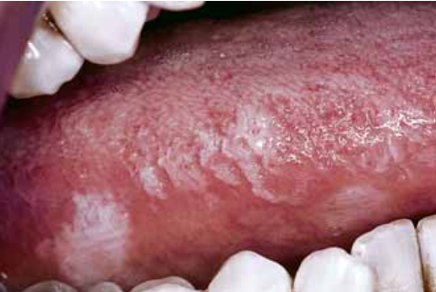
management of hairy leukoplakia is not necessary in that establishment of the diagnosis remains the crucial task
In patients with proven association of hiv/aids, disappearance of the lesion usually accompanies antiretroviral therapy

Slide 12
ORAL LICHEN PLANUS
mucocutaneous disease of immunologic origin
it is mediated by a t-cell lymphocytic reaction
antigenic components within the surface epithelial layer
exogenous antigens that trigger the development of an aberrant immune respons
typically presents as white striaform lesions that are bilaterally symmetric in their distribution

Slide 13
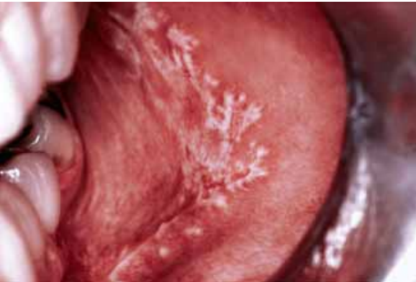
reticular lichen planus
most commonly seen in the middle-aged population.
Over the buccal mucosa in a symmetric bilateral
delicate white keratotic striae that intersect and arborize over a mucosal surface

Slide 14
plaque form
smooth and macular to slightly elevated and minimally fissured
atrophic or erythematous form
faint white striae and is dominated by thinned , reddened mucosa
attached gingiva
a glossy, edematous, and erythematous alteration that is tender and bleeds easily
Bullous variant
range in size from a few millimeters to greater than 1 cm
transient, and on rupturing, painful ulceration results
most lesions noted over the inferior and posterior aspects of the buccal mucosa

Slide 15
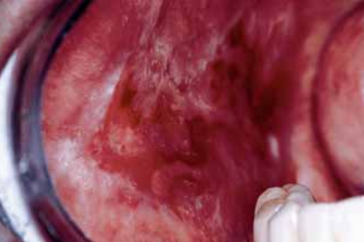
Erosive form
painful ulceration that is usually superficial
typically multifocal pattern of distribution
usually over the lateral and ventral tongue
The ulcer is surfaced by a pseudomembrane or firmly adherent fibrinous plaque ➔usually sharply demarcated.

Slide 16
Treatment:
tell the patient that the goal of management is relief of symptoms, because immediate cure is not to be achieved
Topically agents
corticosteroids
cyclosporine
tacrolimus and pimecrolimus
focal isolated lichen planus ➔ intralesional injections of corticosteroids such as triamcinolone suspension (10 or 40 mg/mL)
Systemic management (cases of severe involvement
brief time corticosteroids
hydroxychloroquine, azathioprine, and systemic retinoids

Slide 17
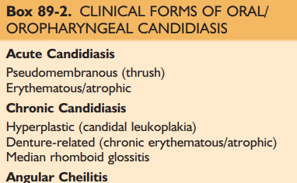
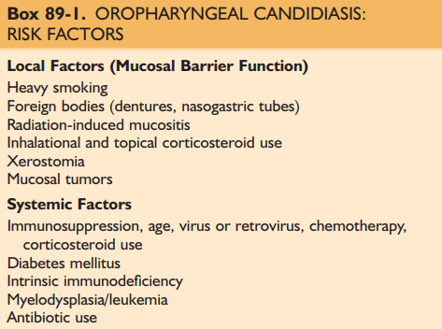
CANDIDIASIS:
pseudomembranous form (thrush)
Erythematous
atrophic
hyperplastic

Slide 18
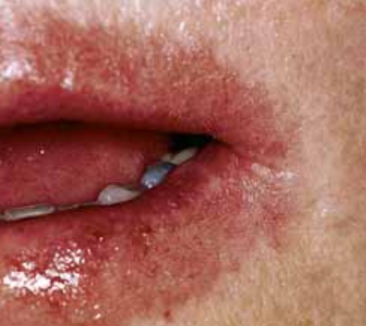
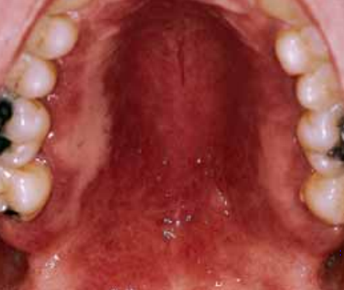

Slide 19
Treatment:
topical nystatin
the azole/triazole group of both topical and systemic agents forms
Systemically administered triazoles—including fluconazole, itraconazole , and ketoconazole—are effective in eradicating more severe forms of this disease

Slide 20
HERPES SIMPLEX VIRUS:
Primary Herpes Simplex Infection:
caused by the human herpesvirus (hhv-1)
the most common virally induced oropharyngeal ulcerative conditions
develops approximately 5 to 7 days subsequent to contact with an infected person
focal mucosal tenderness and erythema, quickly followed by evidence of a group of small vesicles over the oral mucosa
Treatment: considered to be symptomatic and supportive

Slide 21
Recurrent Herpes Simplex Infection:
represents a recrudescent viral infection that occurs in a person previously infected with hhv-1
is characterized by an initial prodromal period during which a focal area of altered sensation develops(a painful tingling or burning)
most commonly involved is over the vermilion portion of the lip
Treatment:
topically docosanol cream and penciclovir cream
In recalcitrant cases
topically applied foscarnet, cidofivir, or imiquimod.

Slide 22
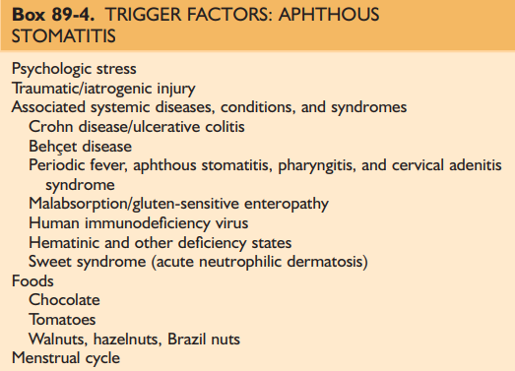
RECURRENT APHTHOUS STOMATITIS:
the most common nontraumatic form of oral ulceration
20% and 40% of the population
chiefly affects the oral and oropharyngeal mucosa and, less commonly, the genital mucosa
Minor , major , herpetiform types

Slide 23
Treatment:
mild and infrequent episodes of minor aphthous➔
symptomatic management and chlorhexidine rinses
severe or occur as a continuous series of outbreaks ➔
short-term administration of systemic corticosteroids
of larger (major) aphthae or in those less than fully responsive to other forms of treatment ➔ Intralesional steroid delivery can be useful in cases
other systemic immunosuppressive drugs
azathioprine, colchicine, pentoxifylline, thalidomide, dapsone, and tumor necrosis factor-α antagonists

Slide 24
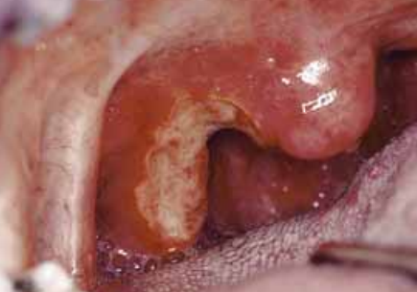
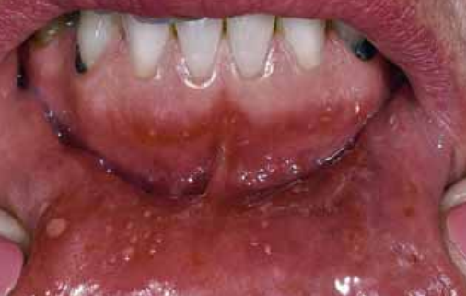

Slide 25
Other lesions:
vesiculobullous and ulcerative lesions.(pemphigus vulgaris , mucous membrane
cicatricial pemphigoid ,..)
erythema multiforme
traumatic (eosinophilic) granuloma
pigmented lesions (melanotic macules , melanoma , amalgam tattoo ,..)
…

